Slide 1
The History of Transnistrian Currency
Aaron Wales
July 2024

Slide 2
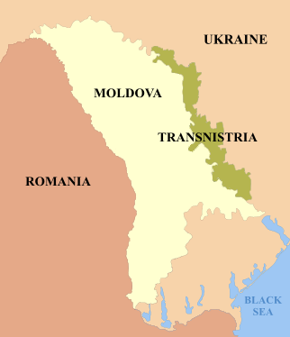
What is Transnistria?
Break away state recognized as part of Moldova
Founded on September 2, 1990
Capital is Tiraspol
Population of 469,000 people
President is Vadim Krasnoselsky
Languages: Russian, Moldovan, and Ukrainian

Slide 3
History of Transnistria
Over the years, the region has been ruled by the Ottoman Empire, Ukraine, Russia, Romania, and the Soviet Union
1918: Ukraine proclaimed that they owned the land over the left bank of the Dniester River which included what is now Transnistria
1927: Massive uprising of peasants and factory workers in Tiraspol and other cities in southern Ukraine against Soviet authorities
Soviet troops sent to the region to suppress the uprisings causing many deaths
1941: In WWII, Axis forces invaded Transnistria and placed it under Romanian rule
1944: Soviet Union reclaimed control of the region
The Flag of Transnistria

Slide 4
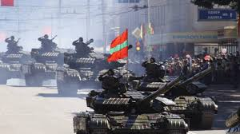
History of Transnistria (Continued)
2 September 1990: Supreme council of Transnistria declared independence from Moldova
25 August 1991: Transnistria declared independence from the Soviet Union
27 August 1991: Moldova declared independence from the Soviet Union.
1990-1992: War of Transnistria. Moldova attempted multiple invasions but failed in all of them
The war started mainly because there was a lot of political tension between Moldova and Transnistria which lead to Transnistria declaring independence from Moldova.
21 July 1992: Ceasefire was signed

Slide 5
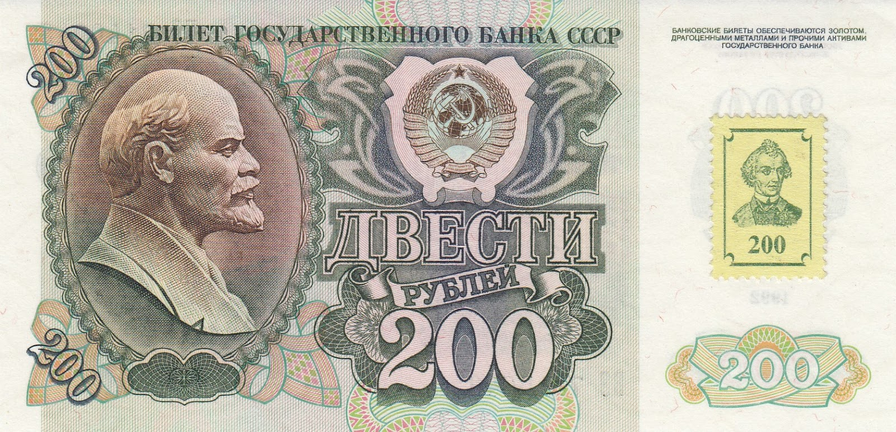
Transnistria Currency: First Ruble (1990-1994)
Around the time that the Soviet Union collapsed, former Soviet territories began issuing their own currency
This meant there was a surplus of Soviet currency available to Transnistria
1993: To protect its financial system the Transnistrian government bought used Soviet notes dated 1961-1992
Adhesive stamps bearing the image of General Alexander Vasilyevich Suvorov, founder of Tiraspol, and the denomination of the note were added

Slide 6
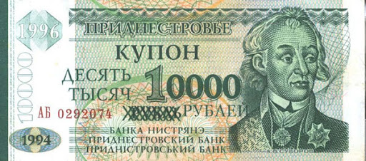
Transnistria Currency: Second Ruble (1994-2000)
First official Transnistrian currency which consisted of only banknotes
The second ruble was equal to 1,000 of the first rubles
High inflation meant that the government had to over-stamp notes to create higher denominations (Ex. 10 became 10,000)
These notes ranged from 1 ruble to 500,000 rubles

Slide 7
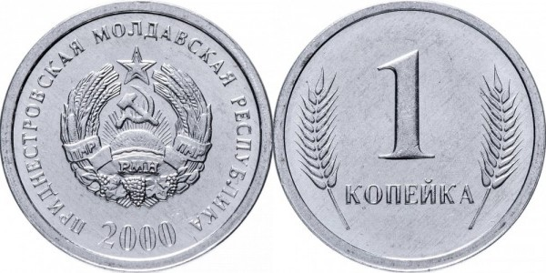
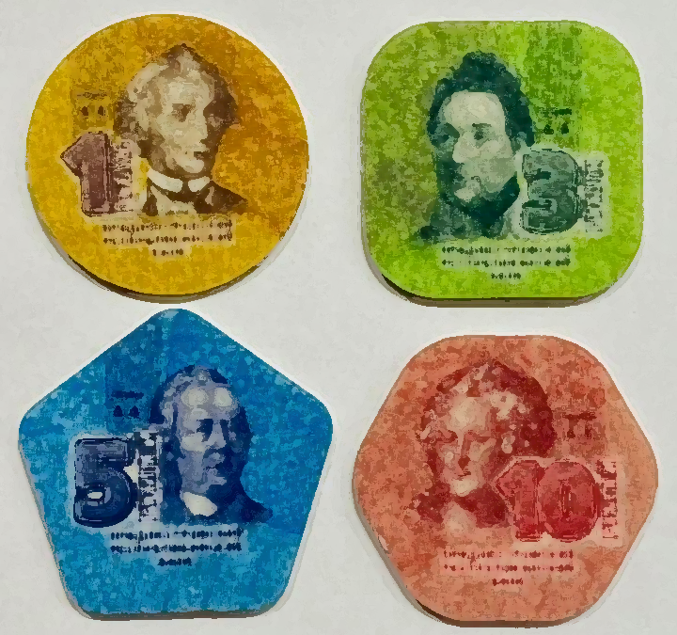
Transnistria Currency: Third Ruble (2000-Present)
A new ruble was introduced in 2000 as part of a currency reform
Still used today and consists of both coins and banknotes
1 third ruble equals 1,000,000 second rubles
Banknote denominations: 1,5,10,25,50,100, 200 and 500 rubles
There are 2 types of coins: a standard kopek which has a rising sun with a hammer and sickle and plastic coins which are highly collectible due to being the world’s only plastic coins
The plastic coins were introduced in 2014 to celebrate the 20th anniversary of official Transnistrian currency
Denominations include the following with each having its own unique shape:
1 ruble - Circle
3 rubles - Square
5 rubles - Pentagon
10 rubles - Hexagon

Slide 8
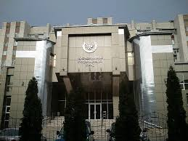
Transnistria Mint
When Transnistria was founded, there was no mint
Transnistria decided to ask the Mint of Poland in Warsaw if they could produce Transnistrian coins and banknotes and they agreed
Shipments of coins and banknotes traveled through Ukraine
Moldova protested against the Poland administration regarding their mint’s relationship with Transnistria
In December 2004, customs in Ukraine confiscated a truck with Transnistrian currency and turned the shipment over to Moldova
Poland’s mint argued they were only producing tokens, not coins, since Transnistria is not officially recognized
April 2005: Poland succumbed to pressure and ended the contract with Transnistria
November 2005: Tiraspol Mint opened
Tiraspol Mint

Slide 9
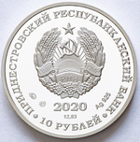
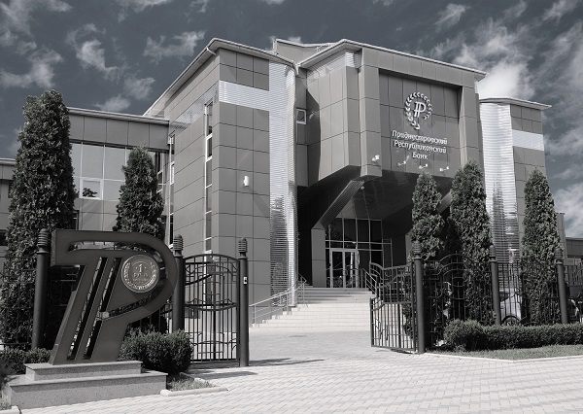
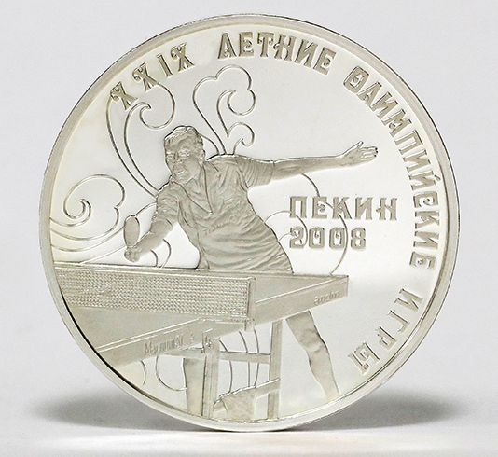
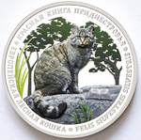
Commemorative Coins
The Tiraspol mint makes commemorative coins that the Transnistrian Republican Bank issues
Sometimes the bank will give free ones to tourists
Obverse: State Emblem/Coat of Arms with the year and denomination
The reverse of every coin is unique for each of the 30 different series
These include the Summer Olympics in Beijing 2008 series (Ex.10 ruble Table Tennis Sportsman in Silver) and the Red Book series (Ex. European Forest Cat 2020 in Silver)
Transnistrian Republican Bank

Slide 10
Conclusion
I find it interesting that Transnistria, being such a small place, has such a fascinating and detailed history not just their currency but also about the region in general. Moreover, I find it interesting how no other country has minted plastic coins. They cost less and are easier to produce.

