Slide 1
Presentation for the Madison County Coin Club
By Mr. T.V. Hutto
Associate Professor of Neurosurgery at the University of Wattamaloo
April 2024

Slide 2
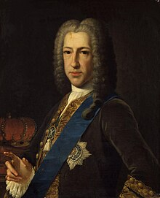
The “King” With No Coins
James III of
Great Britain
“The Old Pretender”

Slide 3
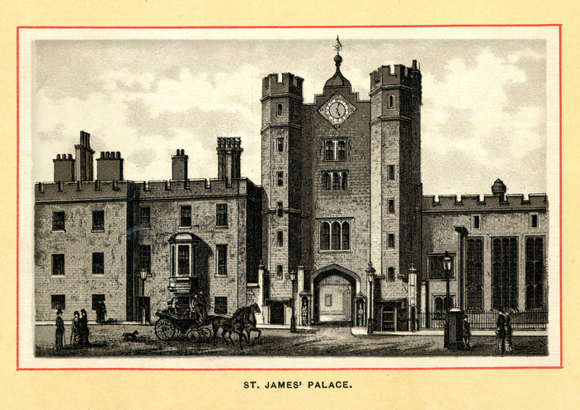
Prince James Edward Francis Stuart, first son of King James II of Britain, and Queen Mary of Modena, was born at St. James Palace, in London, on June 10th, 1688.
Gold Guinea of James II

Slide 4
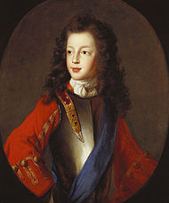
Just after his birth, Prince James was baptized into the Roman Catholic Church.
Prince James was officially declared Prince of Wales in July 1688, just one month after his birth.
The Prince of Wales is traditionally considered next in line to the British Throne.
Prince James
at 15
Silver Crown of James II

Slide 5
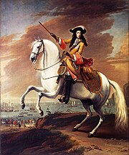
William Invades and James II is Dethroned
With the baptism of Prince James as a Catholic, the prospect of a Catholic British Royal dynasty gravely concerned powerful British leaders, who were predominately Protestant.
Centuries of conflict and war between Protestants and Catholics in the British Isles, raised the specter of new and bloody hostilities.
This concern prompted “The Glorious Revolution of 1688” which forced James II off the Throne. He fled Britain with his Queen and Prince James.
Support was provided to James II’s daughter, Mary, and her Dutch husband William, to invade Britain and claim the British Throne.
William

Slide 6
James III’s father, sisters Mary and Anne, and brother-in-law William, all had official coins struck with their likenesses.
But, not James III…
James II
William and Mary
William III
Anne
1685 to 1688
1689 to 1694
1694 to 1702
1702 to 1714

Slide 7
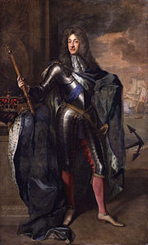
James III - Exiled
James III “held court” in a Roman palace, provided by the Pope. His father, James II died in
1701, so James III claimed the British Throne upon his death.
He bestowed many rights and honors to his loyal followers, known as the Jacobites.
James III, supported by the Kings of France and Spain, as well as the Pope, attempted
an unsuccessful invasion of Britain in 1715, followed by other failed attempts to claim
the throne.
He died in 1766, still in exile, at the age of 77 in Rome.
His claimed reign had lasted for 64 years, 3 months and 16 days, longer than any British monarch until Queen Elizabeth II's reign surpassed it on 23 May 2016
His son, Charles Edward Stuart, “Bonnie Prince Charlie”, took up the cause and invaded Britain, unsuccessfully in 1745. He became known as “The Young Pretender”.

Slide 8
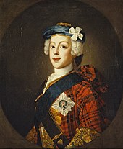
Charles Edward Stuart
“Bonnie Prince Charlie”
“The Young Pretender”

Slide 9

The Son Takes Up The
Father’s Cause
On the 19th of August 1745, Bonnie Prince Charlie raised his standard at Glenfinnan in Lochaber. 1,200 clansmen answered his call and rallied to the Jacobite cause.
Their aim was to restore a Stuart king, Charlie's father, The Old Pretender, to the throne. The attempt failed and in April 1746 the Jacobite uprising ended with a bloody defeat on Culloden Battlefield.
The Memorial at Glenfinnan in honor of the uprising

Slide 10

The Spirit of ‘45
In 1745 Bonnie Prince Charlie landed on the west coast of Scotland to reclaim the Throne of his ancestors. Many Jacobites joined him, but despite early victories, his forces were soundly defeated at the battle of Culloden. This effectively ended the Stuart ambitions for the British Throne.
Charlie escaped to the Isle of Skye, under the protection of the MacKinnon Clan. By way of thanks, Charlie gifted them the only possession he had left, the secret recipe for his personal liqueur. The Clan named it “Drambuie”, after the Gaelic “An Dram Buidheach”, which means “The Drink That Satisfies”.
Just like his father, Charlies never had any official coins minted with his image.

