Slide 1
Odd Denominations
The story of the mid-1800s unusual coin denominations
Stephen D’Angelo – April 2026

Slide 2
US Drama in Coinage
From 1850 to 1878, a series of decisions were made that had ripple effects on American coinage.
Today’s Talk Includes:
  Half Cent Bronze
  Two Cent Nickel
  Three Cent Silver
  Three Cent Nickel
  Twenty Cent Silver
  And some other coins that influenced them!

Slide 3
United States Coinage
1793
1800
1837
Gold Rush
1900
1933
Civil War
Silver
Boom
WW 1
WW 2
1964
1986
2000
2026
½ Cent
LC
DB
Classic
Braided
1 Cent
FH
DB
CL
Coronet
Braided
IH
Indian Head
Lincoln Wheat
Lincoln Memorial
Lincoln Shield
2 Cent
FE
Two Cent
3 Cent
Three Cent
5 Cent
Shield
Liberty “V”
Buffalo
Jefferson v1
Jefferson v2
3 Cent
Three Cent
5 Cent
DB
Cap
Seated Liberty
10 Cent
DB
Capped
Seated Liberty
Barber
Mercury
Roosevelt
Roosevelt
20 Cent
20
Proof only dime/quarter/half
25 Cent
DB
Capped
Seated Liberty
Barber
Standing
Washington v1
Washington v1
Washington v2
v3
50 Cent
DB
Capped
Seated Liberty
Barber
Walking Liberty
Franklin
K
Kennedy
$1.00
DB
G
Seated Liberty
Morgan
P
Ike
SBA
Sacagawea
Trade
Ike
President
Innov
$1.00
T1/2
Type 3
$2.50
TH
Capped
CL
Coronet Head
Indian Head
1 oz Silver Eagle
$3.00
Morgan
Three Dollar
Peace
$4.00
Stella
End of Circulated Gold
End of Circulated Silver
Minting bullion again
1/10 oz Gold Eagle
$5.00
TH
Capped
CL
Coronet Head
Indian Head
¼ oz Gold Eagle
$10.00
Coronet Head
Indian Head
½ oz Gold Eagle
TH
$20.00
Coronet Head
Saint Gaudens
1 oz Gold Eagle
Notes:
In 1800, we were an agricultural nation. By 1837, with railroads and canals, we were becoming an industrial power.

Slide 4
United States Coinage
1793
1800
1837
Gold Rush
1900
1933
Civil War
Silver
Boom
WW 1
WW 2
1964
1986
2000
2026
½ Cent
LC
DB
Classic
Braided
1 Cent
FH
DB
CL
Coronet
Braided
IH
Indian Head
Lincoln Wheat
Lincoln Memorial
Lincoln Shield
2 Cent
FE
Two Cent
3 Cent
Three Cent
5 Cent
Shield
Liberty “V”
Buffalo
Jefferson v1
Jefferson v2
3 Cent
Three Cent
5 Cent
DB
Cap
Seated Liberty
10 Cent
DB
Capped
Seated Liberty
Barber
Mercury
Roosevelt
Roosevelt
20 Cent
20
Proof only dime/quarter/half
25 Cent
DB
Capped
Seated Liberty
Barber
Standing
Washington v1
Washington v1
Washington v2
v3
50 Cent
DB
Capped
Seated Liberty
Barber
Walking Liberty
Franklin
K
Kennedy
$1.00
DB
G
Seated Liberty
Morgan
P
Ike
SBA
Sacagawea
Trade
Ike
President
Innov
$1.00
T1/2
Type 3
$2.50
TH
Capped
CL
Coronet Head
Indian Head
1 oz Silver Eagle
$3.00
Morgan
Three Dollar
Peace
$4.00
Stella
End of Circulated Gold
End of Circulated Silver
Minting bullion again
1/10 oz Gold Eagle
$5.00
TH
Capped
CL
Coronet Head
Indian Head
¼ oz Gold Eagle
$10.00
Coronet Head
Indian Head
½ oz Gold Eagle
TH
$20.00
Coronet Head
Saint Gaudens
1 oz Gold Eagle
Notes:
Today we’re going to focus on this period

Slide 5
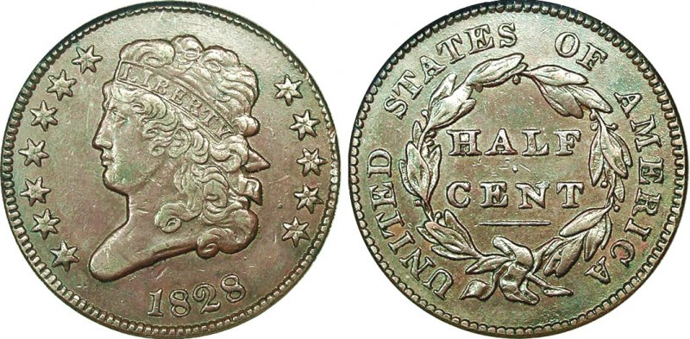
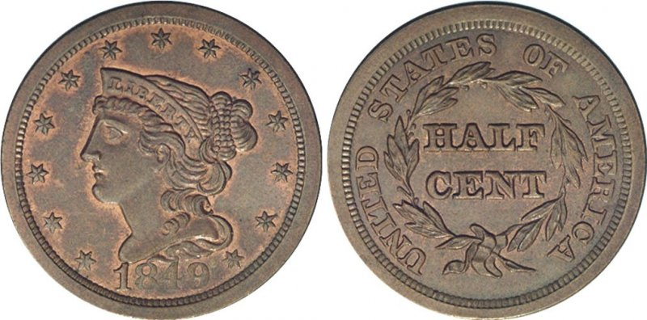
Half Cent
Classic Head
(1809-1836)
3.6 million
Problems
  There was a perceived need from time-to-time for a coin smaller than a cent, but there was inconsistent demand for them.
Classic Head
  Minted in quantity only in 1809-11, 1825-26, 1829, and 1832-35.
Braided Hair
  Minted almost entirely in proof as part of sets for collectors and dignitaries.
  A few years of business strikes in 1849-51 and 1853-57, but in small quantities.
  Disappeared when the new small cent was introduced.
Braided Hair
(1840-1857)
545,000

Slide 6
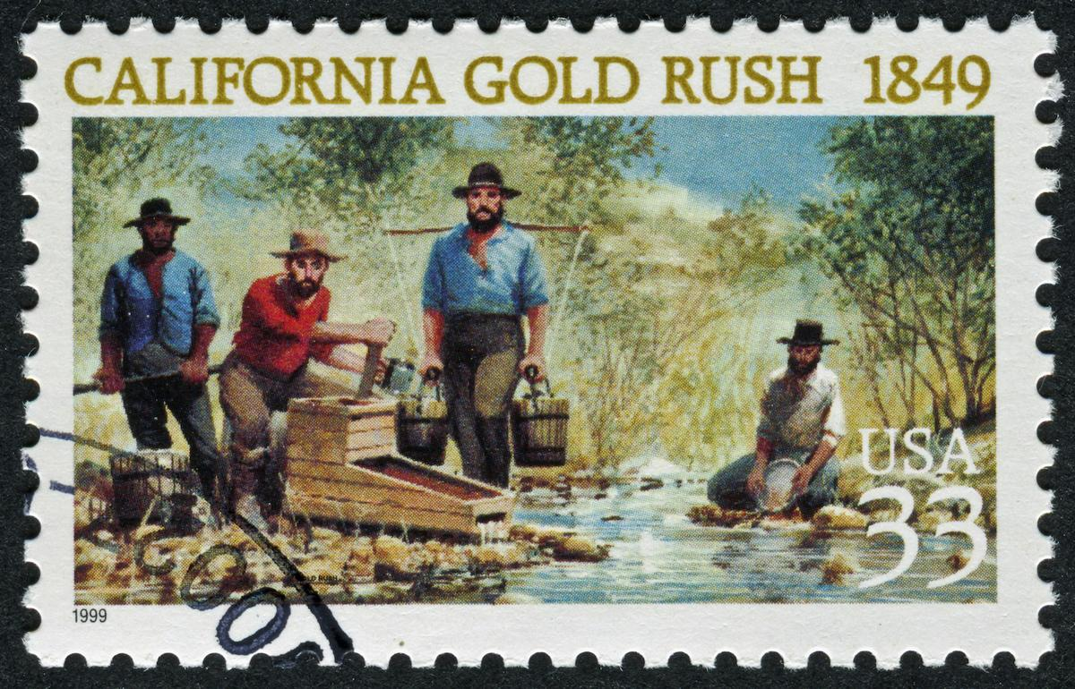
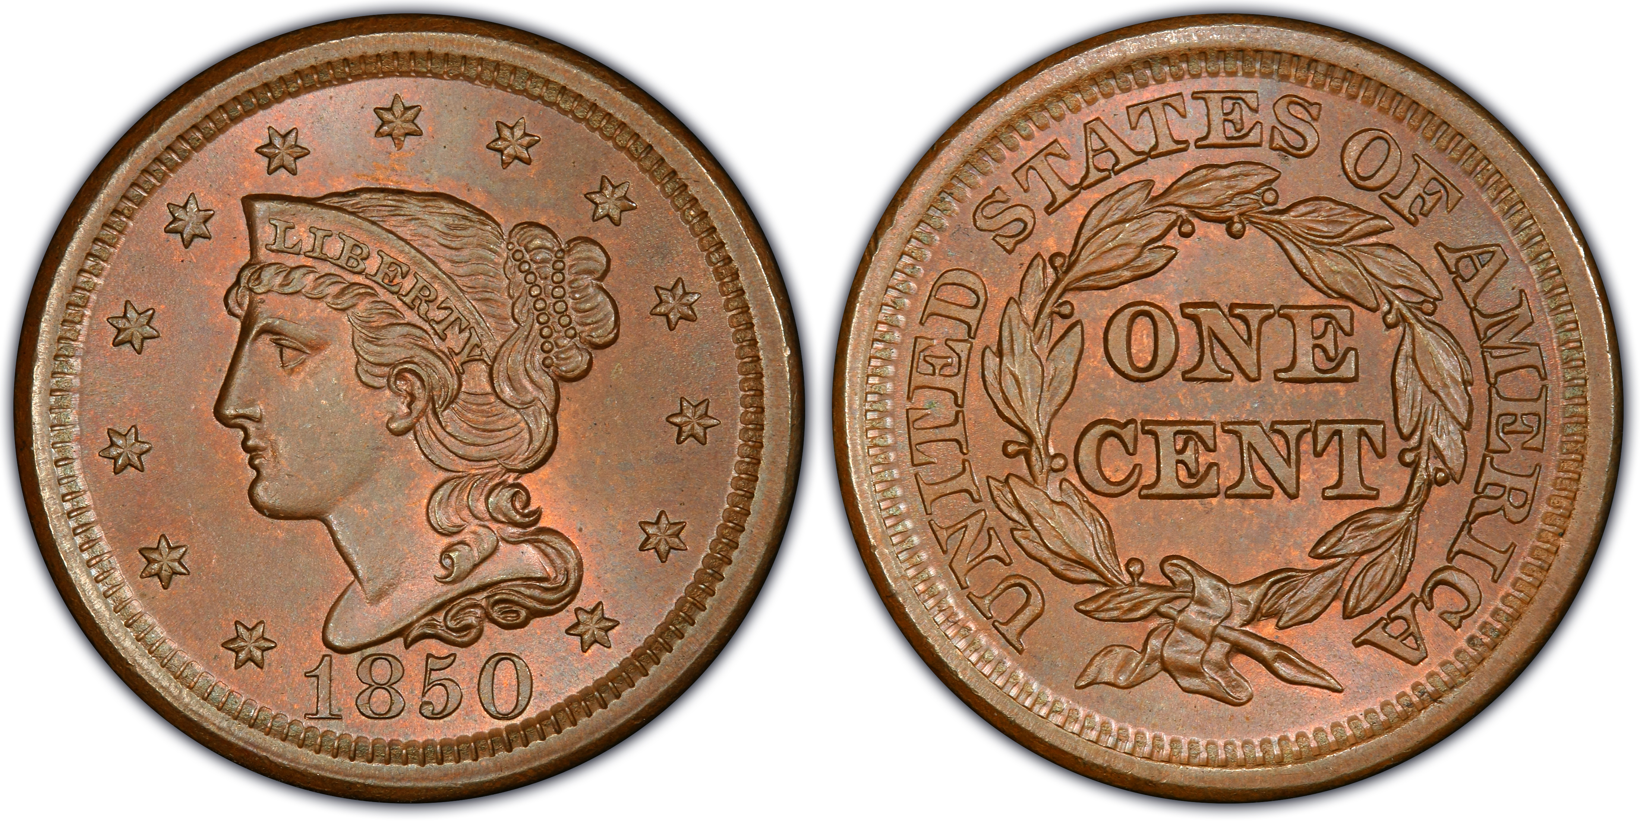
Rushing Problems
California Gold Rush (1849)
  Put a lot of gold into circulation.
  Depressed the value of gold relative to silver, so minted silver was worth more than its face value and was being melted.
  It also wasn’t being minted since silver coins were minted using the customer’s silver.
Inconvenient Copper
  The large cent was cumbersome and inefficient.
  Copper was not trusted in transactions like silver.
Stamp Price Drop from 5 cents to 3 cents (1851)
  The half-dime (5 cent) coin does not allow for smaller transactions.
  Stamps in particular now required change.

Slide 7
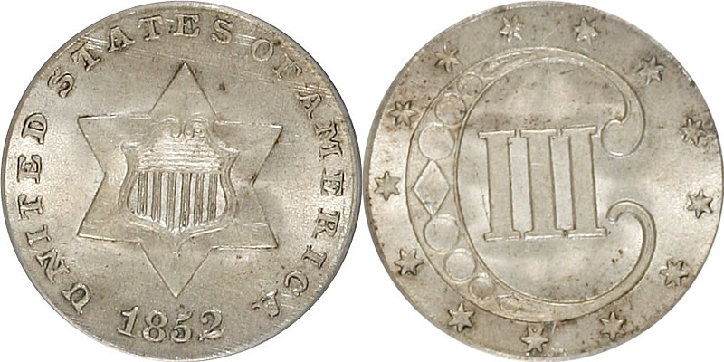
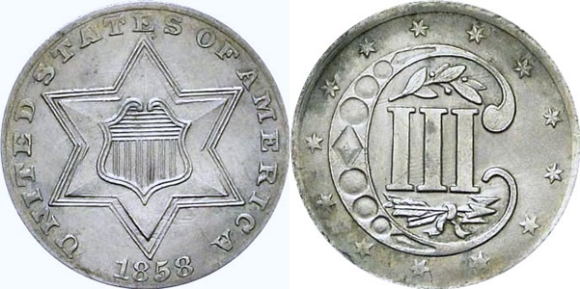
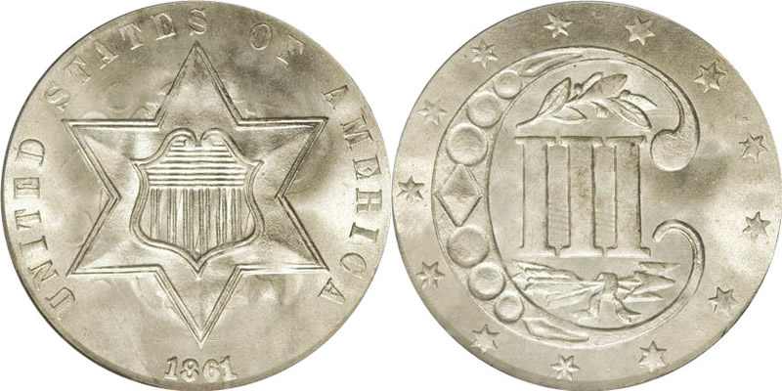
3 Cent Silver
Type 1 (1851-1853) 36 million
Coinage Act of 1851 – The new three cent silver coin.
  Provides a small transaction silver piece.
  75% silver and not full value in silver so it won’t be hoarded.
  Only 0.8 grams… one third the weight of a modern dime!
  Popular initially, but so small, they tended to get lost.
  They also got dirty and were nicknamed “fish scales”.
Deficiency Act of 1853
  Changed to 90% silver (Type 2) in 1854 and made even lighter.
  All other silver coins lowered in weight to make them worth less than face value in silver.
  Silver coins start to circulate again.
Striking Problems
  Type 3 introduced in 1859 to address striking problems.
Type 2 (1854-1858) 4.9 million
Type 3 (1859-1873)1.5 million
Designed by James Longacre

Slide 8
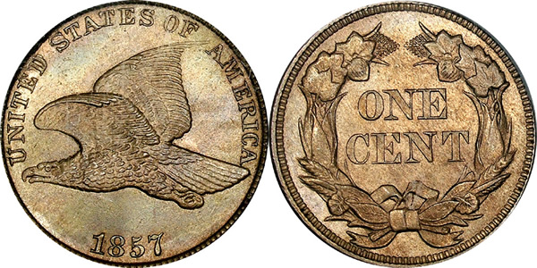
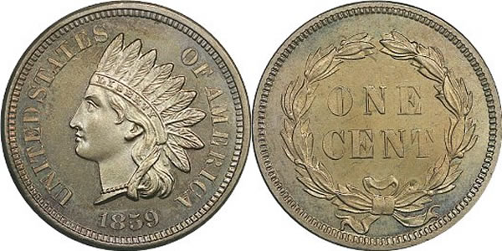
The Small Cent
Problems
  The large cent is getting too expensive to mint… and was the only real profit center.
  The large cent is also annoying to consumers due to its size.
  Many non-US coins were in circulation in the 1850’s, which was becoming a nuisance to “modern” commerce.
Coinage Act of 1857
  The new small cent authorized.
  Mint authorized to exchange the new cents for foreign silver.
Major Changes
  Drains massive quantities of foreign coins (over $3 million in the first year) and puts a lot of small cents into circulation.
  Drains most large cents from circulation and many are melted.
Flying Eagle
(1856-1858)
42 million
Indian Head
(1859-1909)

Slide 9
Too Many Cents
Problems
  The small cent was so successful that it became ubiquitous in daily transactions.
  There were over 100 million of them in circulation.
  Those who considered copper to not be “real money” campaigned against them.
Coinage Act of 1860
  Copper cents are only considered legal tender for up to 4 cents per transaction!
  While many accepted them anyway, merchants could reject cents if they wanted to.
Confusion and disagreement abounds on the use of cents.
Flying Eagle
(1856-1858)
42 million
Indian Head
(1859-1909)

Slide 10
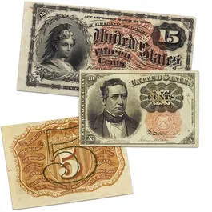
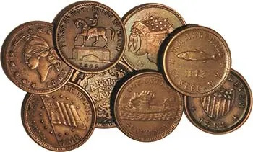
The Civil War
Fractional Currency
Silver Becomes Scarce
  By 1862, silver was needed by both sides for international payments and primary contracts, so the government minted silver didn’t widely circulate to the public.
  When it did, people hoarded and hid it to avoid confiscation.
Paper Notes
  The government widely issued paper notes.
  Act of July 1862 makes postage stamps legal tender.
  The mint responds (without authorization initially) to print “Fractional Currency” paper notes in values of 5, 10, 25, and 50 cents. These were sometimes called “shinplasters”.
The Cent Dominates
  The only widely circulating coin for years was the 1 cent!
  They were copper/nickel until 1864, then bronze (copper/tin).
Civil War Tokens
  Third parties also issued tokens that became popular currency.
Civil War Tokens

Slide 11
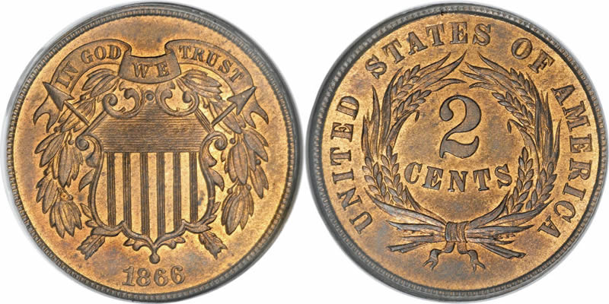
2 Cent Bronze
Problems
  With so little government coinage around and a lot of “tokens”, there was a need for more.
  Until this time, the mint believed no one wanted low values like this, but the “tokens” changed their mind.
Coinage Act of 1864
  Authorized 2-cent coin.
  The first US coin with “In God We Trust” on it.
Widely Accepted
  Starved for coins, these were popular for 2 years, with most of the coins being minted in those two years (20 million and 13.6 million), then they dropped off and faded out by 1873.
Two Cents (1864-1873) 45 million
Designed by James Longacre
Bronze (95% copper / 5% tin)

Slide 12
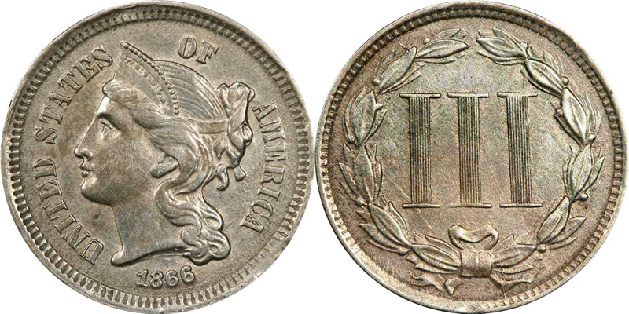
3 Cent Nickel
Problems
  The same lack of coinage continued and since silver coins would not stay in circulation, another solution was looked at.
Coinage Act of 1865 – The new 3-cent nickel coin.
  Minted at the same time as 3-cent silver.
  A generally pretty design.
Result
  Successfully drains fractional currency notes from circulation.
  About 23 million were minted in the first 4 years, then mintage dropped off dramatically in 1871.
3 Cent Nickel (1865-1889)
31.4 million
Designed by James Longacre
“Nickel” (75% copper / 25% nickel)

Slide 13
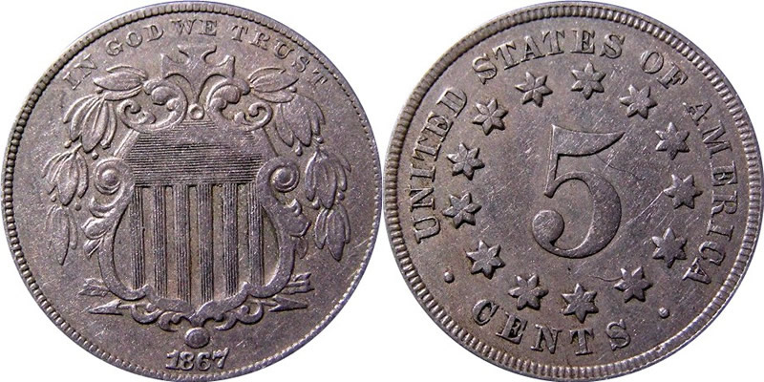
Why not Take 5?
Coinage Age of 1866 – The 5-cent nickel coin
  Followed on the success of the 3-cent but was even more popular.
Coinage Act of 1890
  Postal rates went from 3 cents to 5 cents, ending demand for the 3 cent coins.
  Many were returned and melted to make Liberty Nickels.
5 Cent Nickel (1866-1883)
139 million
Designed by James Longacre
“Nickel” (75% copper / 25% nickel)

Slide 14
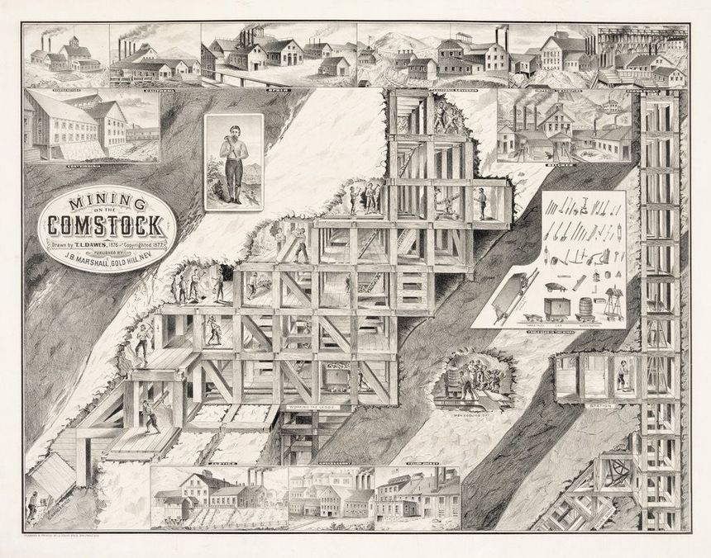
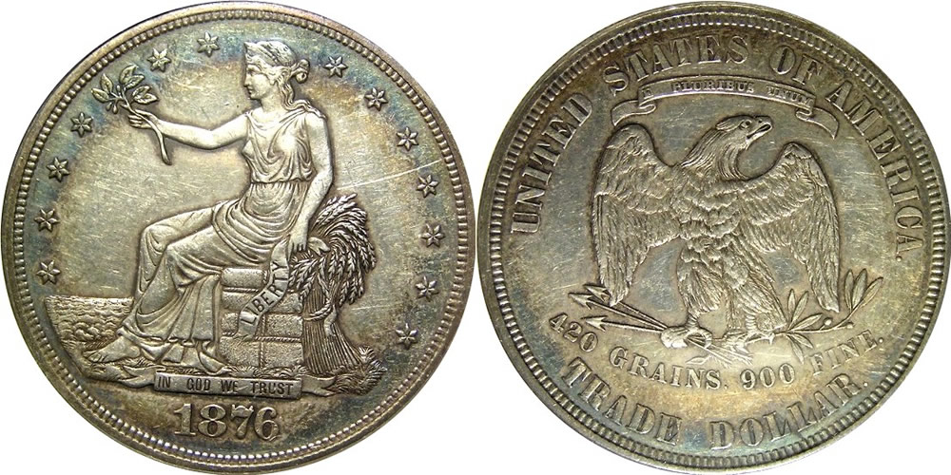
The Comstock Lode
The Comstock Lode
  Silver was found in Nevada in 1859 and was mined heavily through 1874.
  With the end of the California Gold Rush and the new influx of silver following the Civil War, the relative price of silver dropped
Silver Coinage Returns
  Starting in 1871 but not common until 1876.
Coinage Act of 1873
  Eliminates the silver trime (3-cent), half dime (5 cent), and dollar.
  Small coinage (under 10 cents) is now entirely bronze and nickel.
The Trade Dollar
  With lots of silver on hand and no longer being able to mint dollars, the “Trade Dollar” was conceived as not legal tender for trade to China. Later became legal tender.
  Only heavily minted until 1878.
Trade Dollar
(1873-1885)
36 million

Slide 15
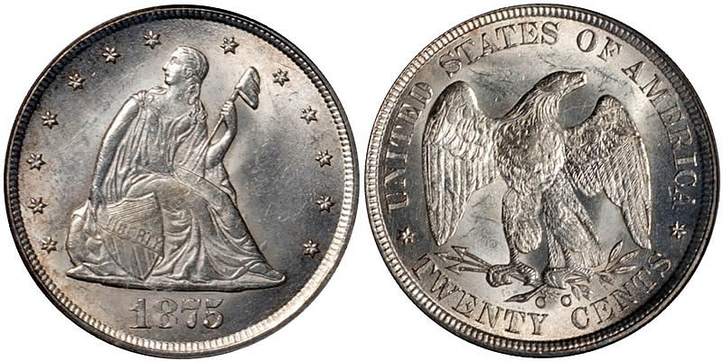
20 Cent Silver
Problems
  Originally proposed in 1783, the Mint Act of 1792 authorized the quarter dollar because it was closer to the Spanish Two Reales that were in widespread use.
  In the west, silver was common, and they didn’t use the new bronze and nickel coins, but the west coast mints were not allowed to mint smaller denominations.
Mint Act of 1875
  Authorized the 20-cent silver piece.
  Most of the mintage was at San Francisco in 1875 (1.15 million) and Carson City (133,000).
  The public disliked the coin and confused it with the quarter.
  Repealed in the Mint Act of 1878.
  Remaining stock was ordered to be melted, so the later years are hard to find.
20 Cent Silver (1875-1878)
1.3 million
Designed by William Barber
90% Silver / 10% Copper

Slide 16
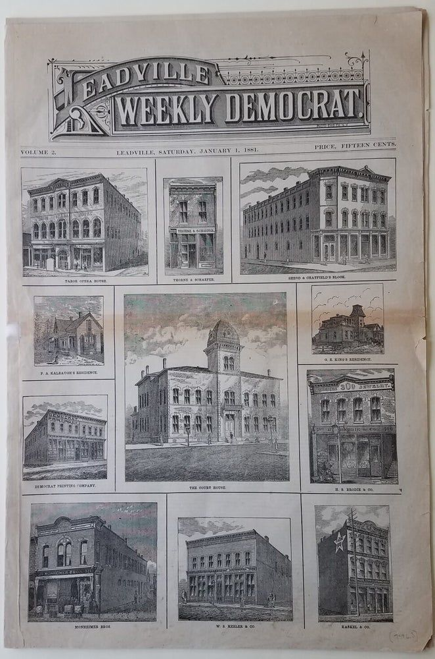
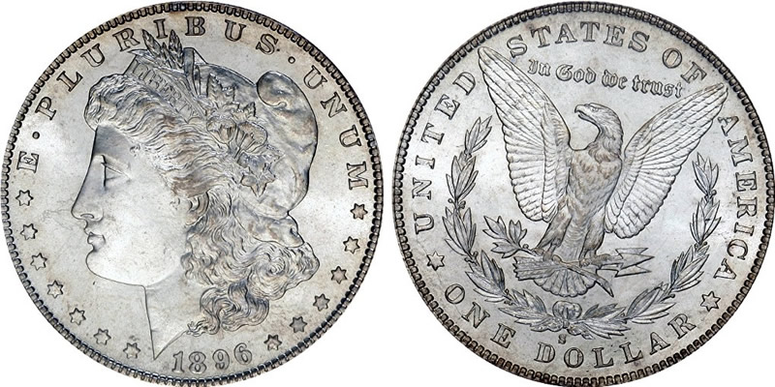
The Colorado Silver Boom
Bland-Allison Act of 1878
  Requires the government to purchase silver in quantity to make silver dollars.
  Drove silver prices up again but drove the relative value to gold down.
Colorado Silver Boom
  Silver was found in Leadville in 1879 and was followed by massive amounts of silver from Colorado.
Morgan Dollar
  The Morgan dollar is minted in large quantities.
  The Trade dollar disappears.
Morgan Dollar
(1878-1904,1921)
306 million

Slide 17
The Odd Denominations
2 Cent (1864-1873) 45 million
3 Cent Silver (1851-1873) 43 million
3 Cent Nickel (1865-1889) 31.4 million
20 Cent Silver (1875-1878) 1.3 million

Slide 18
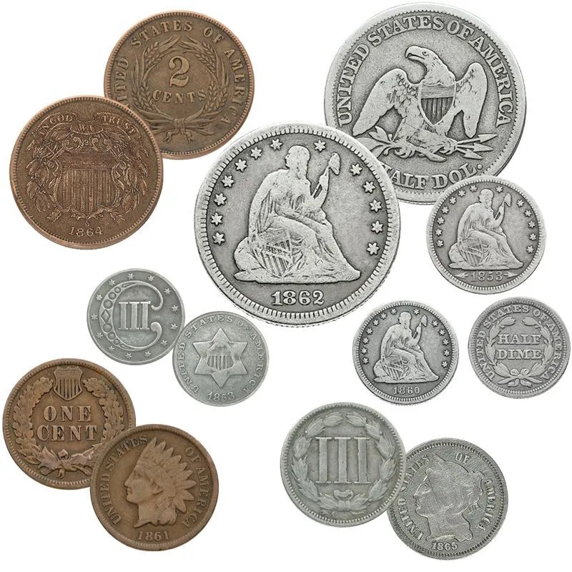
Size Comparison
3 Cent Silver (14.0 mm)
Half Dime Silver (15.5 mm)
3 Cent Nickel (17.9 mm)
Dime (17.9 mm)
Cent (19.0 mm)
Nickel (20.5 mm)
20 Cents (22.0 mm)
2 Cent Bronze (23.0 mm)
Quarter (24.3 mm)
Half Dollar (30.6 mm)
Dollar (38.1 mm)

Slide 19
United States Coinage
1793
1800
1837
Gold Rush
1900
1933
Civil War
Silver
Boom
WW 1
WW 2
1964
1986
2000
2026
½ Cent
LC
DB
Classic
Braided
1 Cent
FH
DB
CL
Coronet
Braided
IH
Indian Head
Lincoln Wheat
Lincoln Memorial
Lincoln Shield
2 Cent
FE
Two Cent
3 Cent
Three Cent
5 Cent
Shield
Liberty “V”
Buffalo
Jefferson v1
Jefferson v2
3 Cent
Three Cent
5 Cent
DB
Cap
Seated Liberty
10 Cent
DB
Capped
Seated Liberty
Barber
Mercury
Roosevelt
Roosevelt
20 Cent
20
Proof only dime/quarter/half
25 Cent
DB
Capped
Seated Liberty
Barber
Standing
Washington v1
Washington v1
Washington v2
v3
50 Cent
DB
Capped
Seated Liberty
Barber
Walking Liberty
Franklin
K
Kennedy
$1.00
DB
G
Seated Liberty
Morgan
P
Ike
SBA
Sacagawea
Trade
Ike
President
Innov
$1.00
T1/2
Type 3
$2.50
TH
Capped
CL
Coronet Head
Indian Head
1 oz Silver Eagle
$3.00
Morgan
Three Dollar
Peace
$4.00
Stella
End of Circulated Gold
End of Circulated Silver
Minting bullion again
1/10 oz Gold Eagle
$5.00
TH
Capped
CL
Coronet Head
Indian Head
¼ oz Gold Eagle
$10.00
Coronet Head
Indian Head
½ oz Gold Eagle
TH
$20.00
Coronet Head
Saint Gaudens
1 oz Gold Eagle
Notes:
In 1800, we were an agricultural nation. By 1837, with railroads and canals, we were becoming an industrial power.

