Slide 1
Human Habits and Numismatic Discoveries
Madison County Coin Club
Chad Thrasher
May 20, 2024

Slide 2
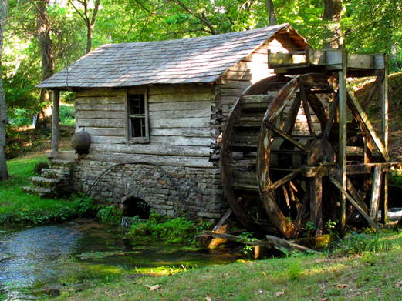
Let me tell you a story…
Over a decade ago a friend shared with me that couple had bought a farm in middle Tennessee. The farm was originally built in the mid- 1800s (1830-1850).
They first remolded the main house and after a few years decided remodel a mill building into a guest house.
While tearing out the interior walls, they found an old large clay jar sealed with wax. The jar was very heavy and took a metal plate and at least two people to move it.
In the jar was cloth bags containing pre-civil war coins. I didn’t get any details, but my friend believed at least a few were silver.
That made me ask, How frequently are coins hidden and lost?
(Ellis, 5)

Slide 3
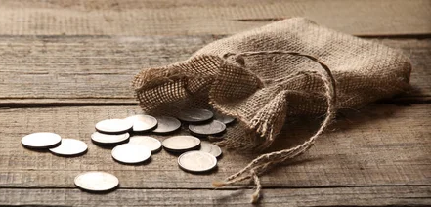
Secondhand Experience
A few years after the previous experience, another friend shared with me that he had purchased a house in Southeast Huntsville, just west of the South Parkway.
One day he was making repairs and cleaning vents and ducts.
In three of the ducts, he found small bags containing post-WWII silver coins (Peace dollars, Franklin and Kennedy half dollars, and silver Washington quarters (90% silver). Each bag held 15-25 coins, so it was a nice find.
This reminded me that my grandparents would hide small stashes of coins and bills in various tins in closets, between the pages of encyclopedias, in containers and boxes in the workshop, and other places because they had lived through the Great Depression and didn’t trust banks!
Is, or was, hiding coins common? And why?
(Unknown, 20)

Slide 4
Two Other Southeastern Hoards
Hoard Name Discovery Date | Details | Coins Found
Randall Hoard¹⁷ Discovered before 1869 | Found by John Randall beneath a railway station platform in Georgia after the civil war. | Appx. 5000 large copper U.S. cents dated 1816 - 1820 and 1825
Kentucky Coin Hoard⁴ Discovered in 2023 | Discovered in a western Kentucky cornfield by group with metal detectors. | Appx. 800 U.S. gold coins From “the civil war era” (1860-1865)* $1, $10, and $20 coins, including eighteen (18) 1863 (P) $20 coins *but included a 1901 $10 coin
Seems like a common practice in the Southeast.
Especially, before and during the civil war and times of uncertainty.
But is this consistent across the United States?

Slide 5
Saddle Ridge and other U.S. Hoards
Hoard Name Discovery Date | Details | Coins Found
Saddle Ridge Hoard⁴ Discovered in 2013 | Found by a couple walking their dog in Saddle Ridge, California. | 1,411 U.S. gold coins, 1847 - 1894, most were “S” mint and included some 1840-D $5 (Half Eagles) Liberty Heads

Slide 6
Saddle Ridge and other U.S. Hoards
Hoard Name Discovery Date | Details | Coins Found
Saddle Ridge Hoard⁴ Discovered in 2013 | Found by a couple walking their dog in Saddle Ridge, California. | 1,411 U.S. gold coins, 1847 - 1894, most were “S” mint and included some 1840-D $5 (Half Eagles) Liberty Heads
Baltimore Gold Hoard⁴ Found on Aug. 31, 1934, and in 1935. | Discovered by two boys (Theodore Jones, 16 & Henry Grob, 15) while digging in a cellar. Awarded $7,000 each in 1937 legal dispute. | Over 3,500 U.S. gold coins From dated from 1830’s – 1850s $1, $5, $10, and $20 denominations.

Slide 7
Saddle Ridge and other U.S. Hoards
Hoard Name Discovery Date | Details | Coins Found
Saddle Ridge Hoard⁴ Discovered in 2013 | Found by a couple walking their dog in Saddle Ridge, California. | 1,411 U.S. gold coins, 1847 - 1894, most were “S” mint and included some 1840-D $5 (Half Eagles) Liberty Heads
Baltimore Gold Hoard⁴ Found on Aug. 31, 1934, and in 1935. | Discovered by two boys (Theodore Jones, 16 & Henry Grob, 15) while digging in a cellar. Awarded $7,000 each in 1937 legal dispute. | Over 3,500 U.S. gold coins From dated from 1830’s – 1850s $1, $5, $10, and $20 denominations.
Lovelock, Nevada² Beginning in 1975 | The Nevada Dept. of Transportation conducted archaeological digs before building I-80. Coin cashes were found in three (3) different cellar locations. | 112 U.S. gold coins, 1874 - 1910, 21 $5, 11 $10, and 80 $20 pieces most “S” with a few “P” and one CC 50 U.S. coins including pennies, nickels, dimes and one 1899-O $1. Two locations with ~90 Chinese and Japanese, and other oriental coins.
Make eye contact with your audience to create a sense of intimacy and involvement

Slide 8
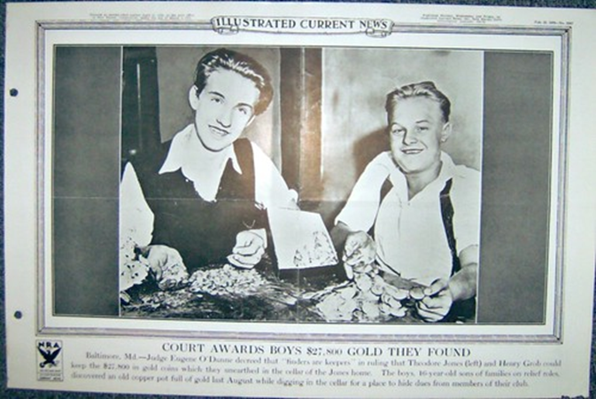
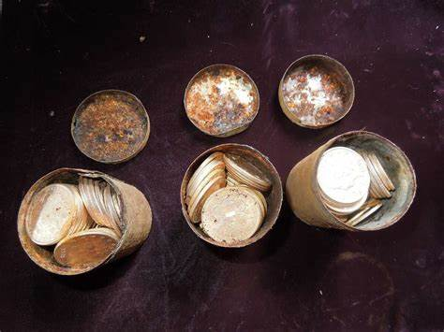
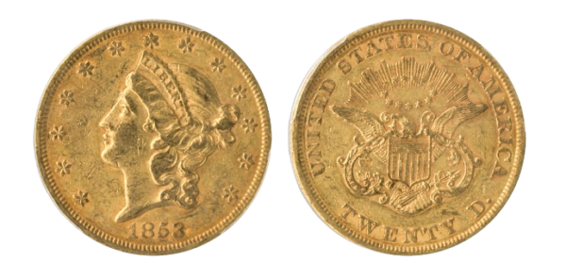
Pictures
(Egerton, 4, Baltimore Gold Hoard)
(Egerton, 4, Saddle Ridge Hoard)
(Egerton, 4, Kentucky Coin Hoard)

Slide 9
Is this a human habit?
What is a habit?
1. a settled or regular tendency or practice, especially one that is hard to give up
2. a settled tendency or usual manner of behavior – per Merriam Webster⁶
If it is a Human Habit, then it should be global.
9

Slide 10
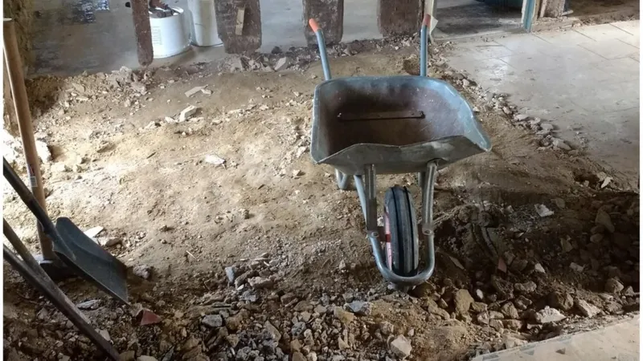
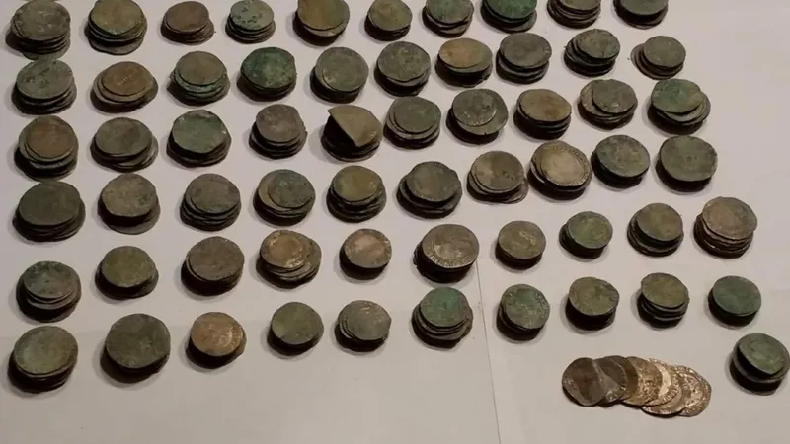
England
Hoard Name Discovery Date | Details | Coins Found
Dorset Hoard¹ Discovered in 2019 | Found while digging up a kitchen floor in a 400-year-old cottage to install new heating pipes in a South Poorton Farm in Dorset England. | 1000+ gold and silver coins dated 1547 – 1649 included six-pences, half-crowns, and crowns depicted Queen Elizabeth I, Queen Mary, and King Charles I (First English Civil War 1642 – 1646).
(Binswanger, 1)
(Binswanger, 1)

Slide 11
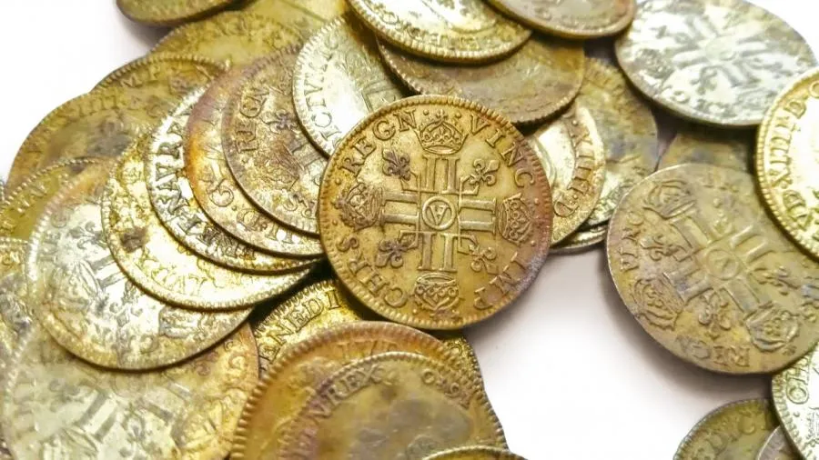
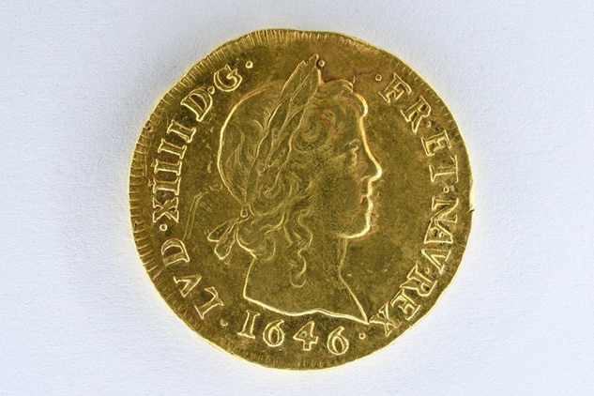
France
Hoard Name Discovery Date | Details | Coins Found
Brittany, France¹³ Discovered in Oct. 2019 | Discovered by a group of 3 construction workers renovating a historic mansion. The coins were in a metal box found within a wall. | 239 rare gold French coins, minted during the reigns of Louis XIII (1610 – 1643) and Louis XIV (1643 – 1715). It included a 1646 “double” Louis d’Or – only 120 are known to exist.
(McGreevy,13)
(McGreevy, 13)

Slide 12
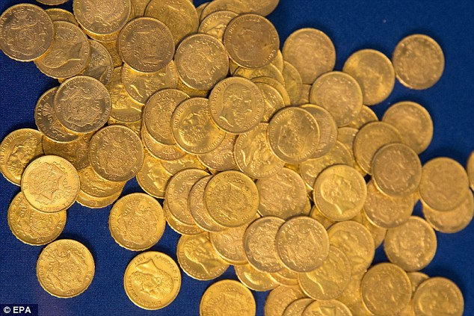
Germany
Hoard Name Discovery Date | Details | Coins Found
Lueneburg, Germany^{9, 12} Discovered in 2015 | Florian Bautsch found 10 coins in a hollow of a tree trunk with a metal detector – then professions excavated another 210. found under a 50-year-old tree indicates it hidden at the end of WWII or soon after. | 220 coins dated from 1831 – 1910, French, Belgian, Italian, and Austo-Hungarian in origin
The hoard was found in paper embossed with the Nazi swastika and eagle, bearing the words ‘Reichsbank’.
This suggests the coins were stolen from Germany’s wartime bank and the crime may have been an inside job, as chaos reigned in the final days of the Third Reich.
(Martin, 12)

Slide 13
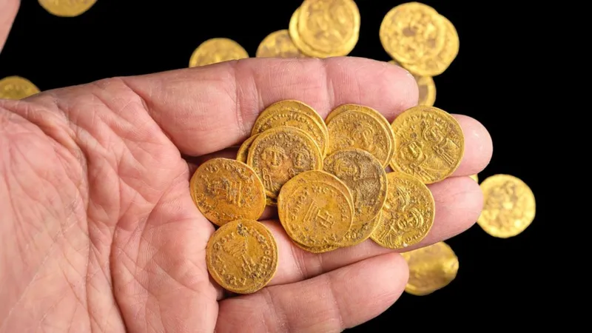
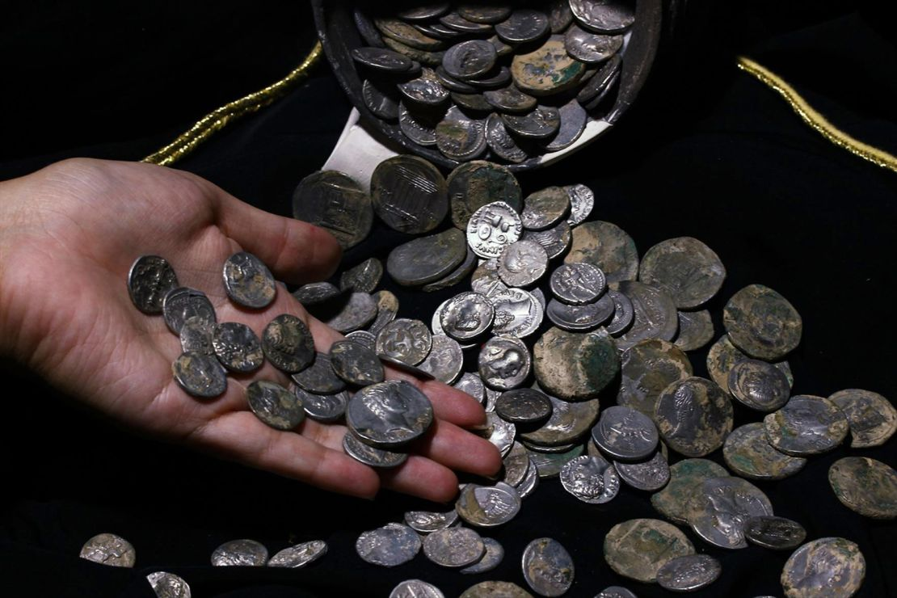
If it is a Human Habit, then it should be global.
Hoard Name Discovery Date | Details | Coins Found
Hermon Stream¹⁹ Discovered in 2022 | Excavation of the city of Banias, Israel. Believed to have been deposited during the Muslim conquest ~635 AD. | 44 gold coins from the period of Emperor Phocas (602 - 610 AD) and his successor Heraclius.
Aizanoi, (Western) Turkey¹⁰ Discovered in 2019 | Found in a clay jug and believed to have been buried by a high-ranking Roman soldier. | 651 silver Roman coins from the period of Emperor Augustus, 44 BC – 14 AD
(BBC.com,19)
(Guy, 10)

Slide 14
Yes, Europe is covered with validated hoards
Romans were litter bugs;
they left coins all over
Europe, the Middle East,
and Asia!
(University of Oxford, 16)
The University of Oxford has documented over 15,285 validated ancient Roman (100 BC – 650 AD) coin hoards containing over 6, 104, 586 coins.¹⁶

Slide 15
What About the Asia?
Hoard Name Discovery Date | Details | Coins Found
Shuangdun Village, Jianhu County, China¹⁴ Discovered Oct. 23, 2022 | Coins were connected to each other by straw ropes and neatly layered in a paved pit 1.63 m x 1.58 m and 0.5 m in depth. Near a battle location of the Jin-Song wars. | ~1.5 tons of bronze cash coins, mostly dating to the Song dynasty.

Slide 16
What About the Asia?
Hoard Name Discovery Date | Details | Coins Found
Shuangdun Village, Jianhu County, China¹⁴ Discovered Oct. 23, 2022 | Coins were connected to each other by straw ropes and neatly layered in a paved pit 1.63 m x 1.58 m and 0.5 m in depth. Near a battle location of the Jin-Song wars. | ~1.5 tons of bronze cash coins, mostly dating to the Song dynasty.
Faliang, Chacun, China⁷ Discovered Oct. 13, 2017 | Government took over the site on Oct. 22nd citing: Article 34 of the Chinese Civil Relic Protection Law reads: “No entity or individual may take any of the cultural relics excavated into its or his own possession.” | ~300,000 copper Song Dynasty (960 – 1279) wen coins weighing ~5.6 tons. Believed to have been buried around 1127 when a nearby city fell to rivals.

Slide 17
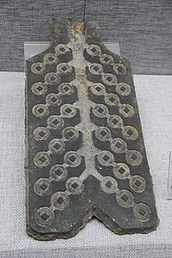
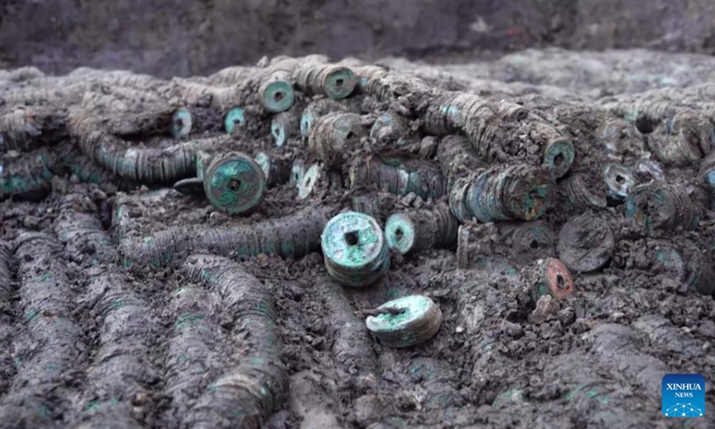
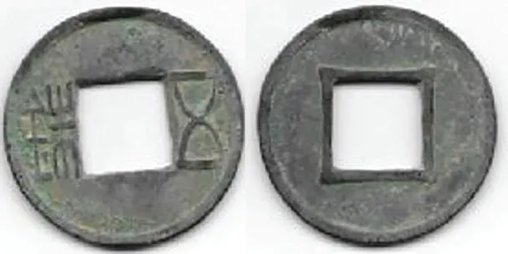
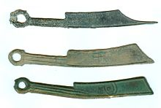
What About the Asia?
(Giedroyc, 8, wu zhu coin, Emperor Liu He)
(Wikipedia, 14, Han dynasty coin mold)
(Тимофій Борзенкоs, 18, In-situ ancient Chinese coins)
(Wikipedia, 14,Yan State knife money)
Some Chinese coins were made using dies as the one pictured on the left. ¹⁴
Prior to round coins, some Knife money was used as in the lower right image.¹⁴
Look up: “List of coin hoards in China” on Wikipedia. There are over 75 individual hoard finds listed!¹⁵

Slide 18
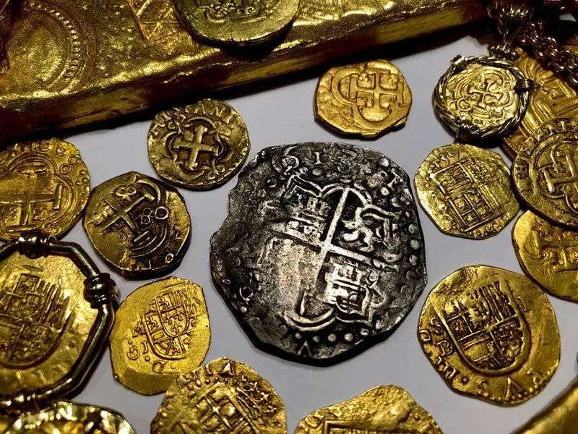
What about South and Central America?
Coins were not made or considered valuable until the arrival of European explorers.
Silver and gold found or mined under the direction of either the Spanish or Portuguese was usually shipped back to Europe.
Unfortunately, or maybe fortunately for at least a few of us, many of the ships didn’t make it back with their treasures. They were sunk by storms or taken by pirates.
The list of coins found in shipwrecks is a presentation for another day.
(Doyle, 3, Pirate Gold Coins)
(Marlar, 11)

Slide 19
Sources
Binswanger, J. (2024, May 08). English Family Finds More Than a Thousand 17th Century Coins During Home Renovation. Smithsonian. https://www.msn.com/en-us/news/world/english-family-finds-more-than-a-thousand-17th-century-coins-during-home-renovation/ar-BB1m3s0Y?ocid=BingNewsSerp
Cassinell, D. (2014, July 25). Hoard of gold coins found in Lovelock. Dennis Cassinelli’s History Column. https://denniscassinelli.com/2014/07/25/lovelock-gold-coins/
Doyle, M. (2024, May 09). 30 of the Most Valuable Shipwreck Treasures Ever Found. https://www.workandmoney.com/s/valuable-shipwreck-treasures-found-713c4b79d17d4130. Workandmoney.com.
Egerton, L. (2024, April 03). The World’s 8 Largest and Most Famous Coin Hoards Discovered to Date. https://www.blanchardgold.com/market-news/famous-coin-hoards/ . www.blanchardgold.com. Blanchard and Company, Inc.
Ellis, Andrea. Photograph of Old Water Mill. “Old Barns” (05 May 2024). Pinterest.com/aellis55/old-water-mills/.
“habit.” Merriam-Webster.com. https://www.merriam-webster.com/dictionary/habit (15 May 2024).
Giedroyc, R. (2018. January 10). Chinese coin hoard weighs tons. https://www.numismaticnews.net/world-coins/chinese-coin-hoard-weighs-tons. Numismaticnews.net.
Giedroyc, R. (2019. December 17). Details of Chinese Coin Hoard Published. https://www.numismaticnews.net/world-coins/details-of-chinese-coin-hoard-published . Numismaticnews.net.
Griffiths, S. (2015. July 15). Nazi gold hoard unearthed: 217 coins found with swastika seal were buried underneath a tree during last days of World War II. https://www.dailymail.co.uk/sciencetech/article-3162591/Gold-hoard-buried-Nazi-era-just-WW2-Germany.html. www.dailymail.co.uk. DailyMail.com.
Guy, J. (2021, February 09). More than 650 silver Roman coins found in a jug in Turkey. https://www.cnn.com/style/article/turkey-roman-coins-scli-intl-scn/index.html. www.cnn.com. CNN.
Marlar, Michelle. Photograph of Replica Pirate Galleon-Genoa, Italy. (2015, October 25). www.youtube.com/watch?v=e3YRNCZvLwU.

Slide 20
Sources
Martin, M. (2015, July 15). Gold hoard buried in Nazi era or just after WW2 found in Germany. https://www.reuters.com/article/idUSKCN0PP22B . www.reuters.com. Reuters.
McGreevy, N. (2021, September 07). Trove of 239 Rare Gold Coins Discovered in Walls of French Mansion. https://www.smithsonianmag.com/smart-news/trove-239-rare-gold-coins-discovered-walls-french-mansion-180978575/. www.smithsonianmag.com. Smithsonian Magazine.
Multiple Authors. (Page last updated: 2024, April 16). Ancient Chinese coinage. https://en.wikipedia.org/wiki/Ancient_Chinese_coinage. Wikipedia.
Multiple Authors. (Page last updated: 2024, May 02). List of coin hoards in China. https://en.wikipedia.org/wiki/List_of_coin_hoards_in_China. Wikipedia.
Multiple Authors. (2023, July 15). Coin Hoards of the Roman Empire. https://chre.ashmus.ox.ac.uk/ . University of Oxford.
Sherman, M. (2014, July 28). A History of Major U.S. Hoards: The Economite Treasure. https://www.pcgs.com/news/a-history-of-major-us-hoards. www.pcgs.com. PCGS.
Тимофій Борзенко (December 15, 2022). "Tonnes of millennia-old coins found in east China. Section: Culture. – An ancient coin hoard containing 1.5 tonnes of coins dating back to the Tang (618–907) and Song (960-1279) dynasties has been discovered in east China's Jiangsu Province".
Ukraine News. Retrieved July 18, 2023. Unknown Author. (2022, October 03). Gold coins hidden in 7th Century found in wall. https://www.bbc.com/news/world-middle-east-63122180. www.bbc.com. BBC.
Unknown. Photograph of bag of silver coins. Stock photo. Royalty Free Bag of Silver coins images. (2024). Depositphotos.com.

Slide 21
Thank you
Chad Thrasher
(256) 479-0263
chadthrasher1@gmail.com

