Slide 1
Coins of German East Africa
By H.K. Fears
January 22, 2024

Slide 2
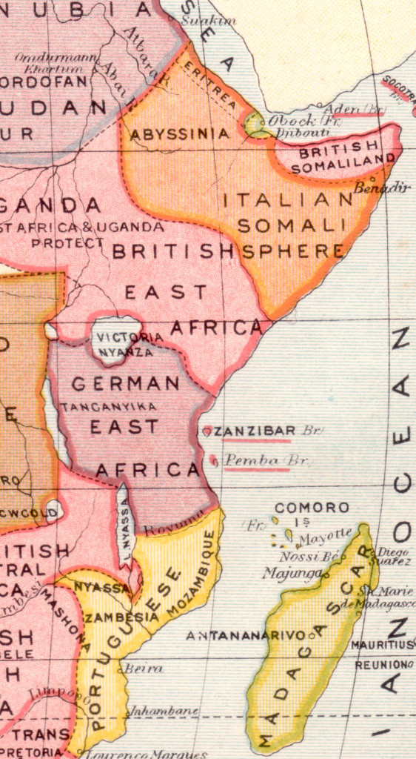
Quick Overview
German East Africa was a territory comprising present-day Tanganyika, Rwanda & Burundi.
These efforts began in 1884 when Dr. Karl Peters, one of the founders of the German Colonization Society, set out for east Africa in search of a suitable colony. In November of that year Peters succeeded in concluding a series of so-called “treaties” with the local chiefs.
German East African Company established the colony in 1885.
The Germans made Tanganyika a state-run colony in 1891.
During WW1 the British and Belgians invaded and annexed German East Africa, after which the League of Nations mandates of Ruanda-Urundi (Belgium) and Tanganyika (Britain) were established.
German East Africa used the German East African Rupee, which was at par with the Indian Rupee and subdivided in 64 Pysa. In 1904, it was decimalised into 100 Heller and a new exchange rate was established at 15 Rupien = 20 German Mark.
During WW1 the Germans minted emergency issues, amongst others a gold 15 Rupien coin which was used to pay the soldiers.

Slide 3
German East Africa Company
During the initial phase of German colonial rule in the region, the German East African Company (Deutsch Ostafrikanische Gesellschaft, DOAG) administered the protectorate on behalf of the German Reich.
In 1890, the Reich granted the DOAG the right to issue coins.
Since this region of East Africa had used the Indian rupee for decades, the DOAG decided to issue rupees and pice (pesa), with the inscription of its name and symbols (its coat of arms) and those of the Reich (the German eagle with crown or the effigy of the emperor).
The DOAG one-rupee coin had the same size and silver content as the Indian one-rupee coin.
These coins were struck only to meet the demands of existing commerce. As might be expected, mintage figures for German East Africa Company coins are low as compared to the later, government issues, making them relatively expensive today.

Slide 4
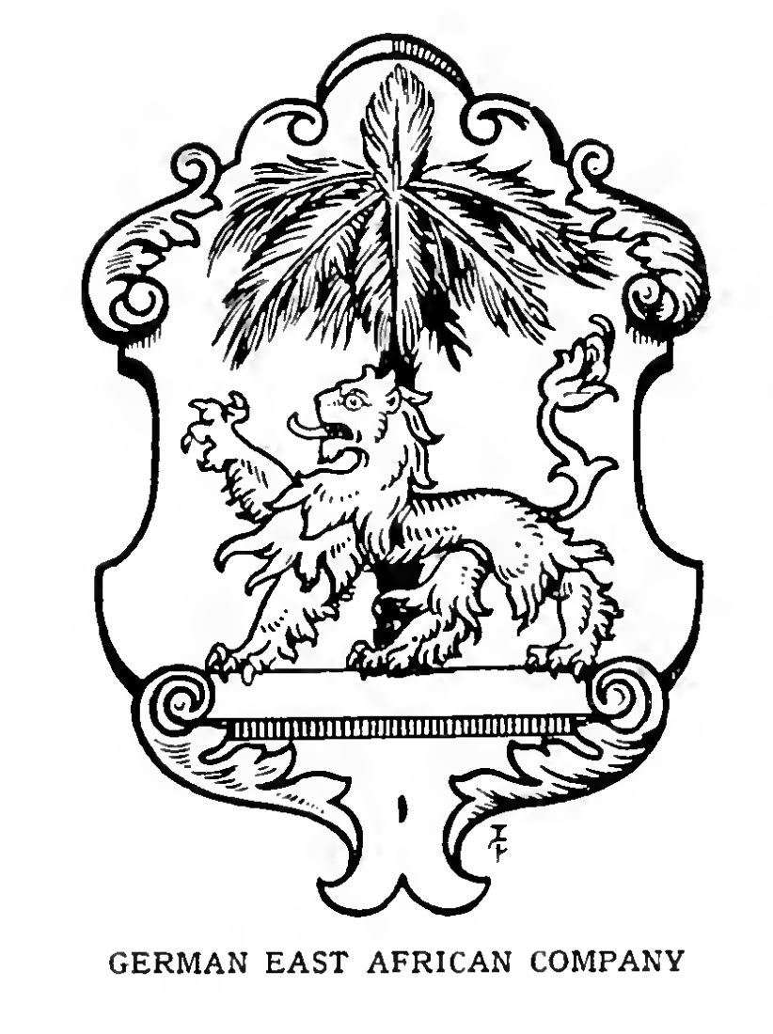

Slide 5
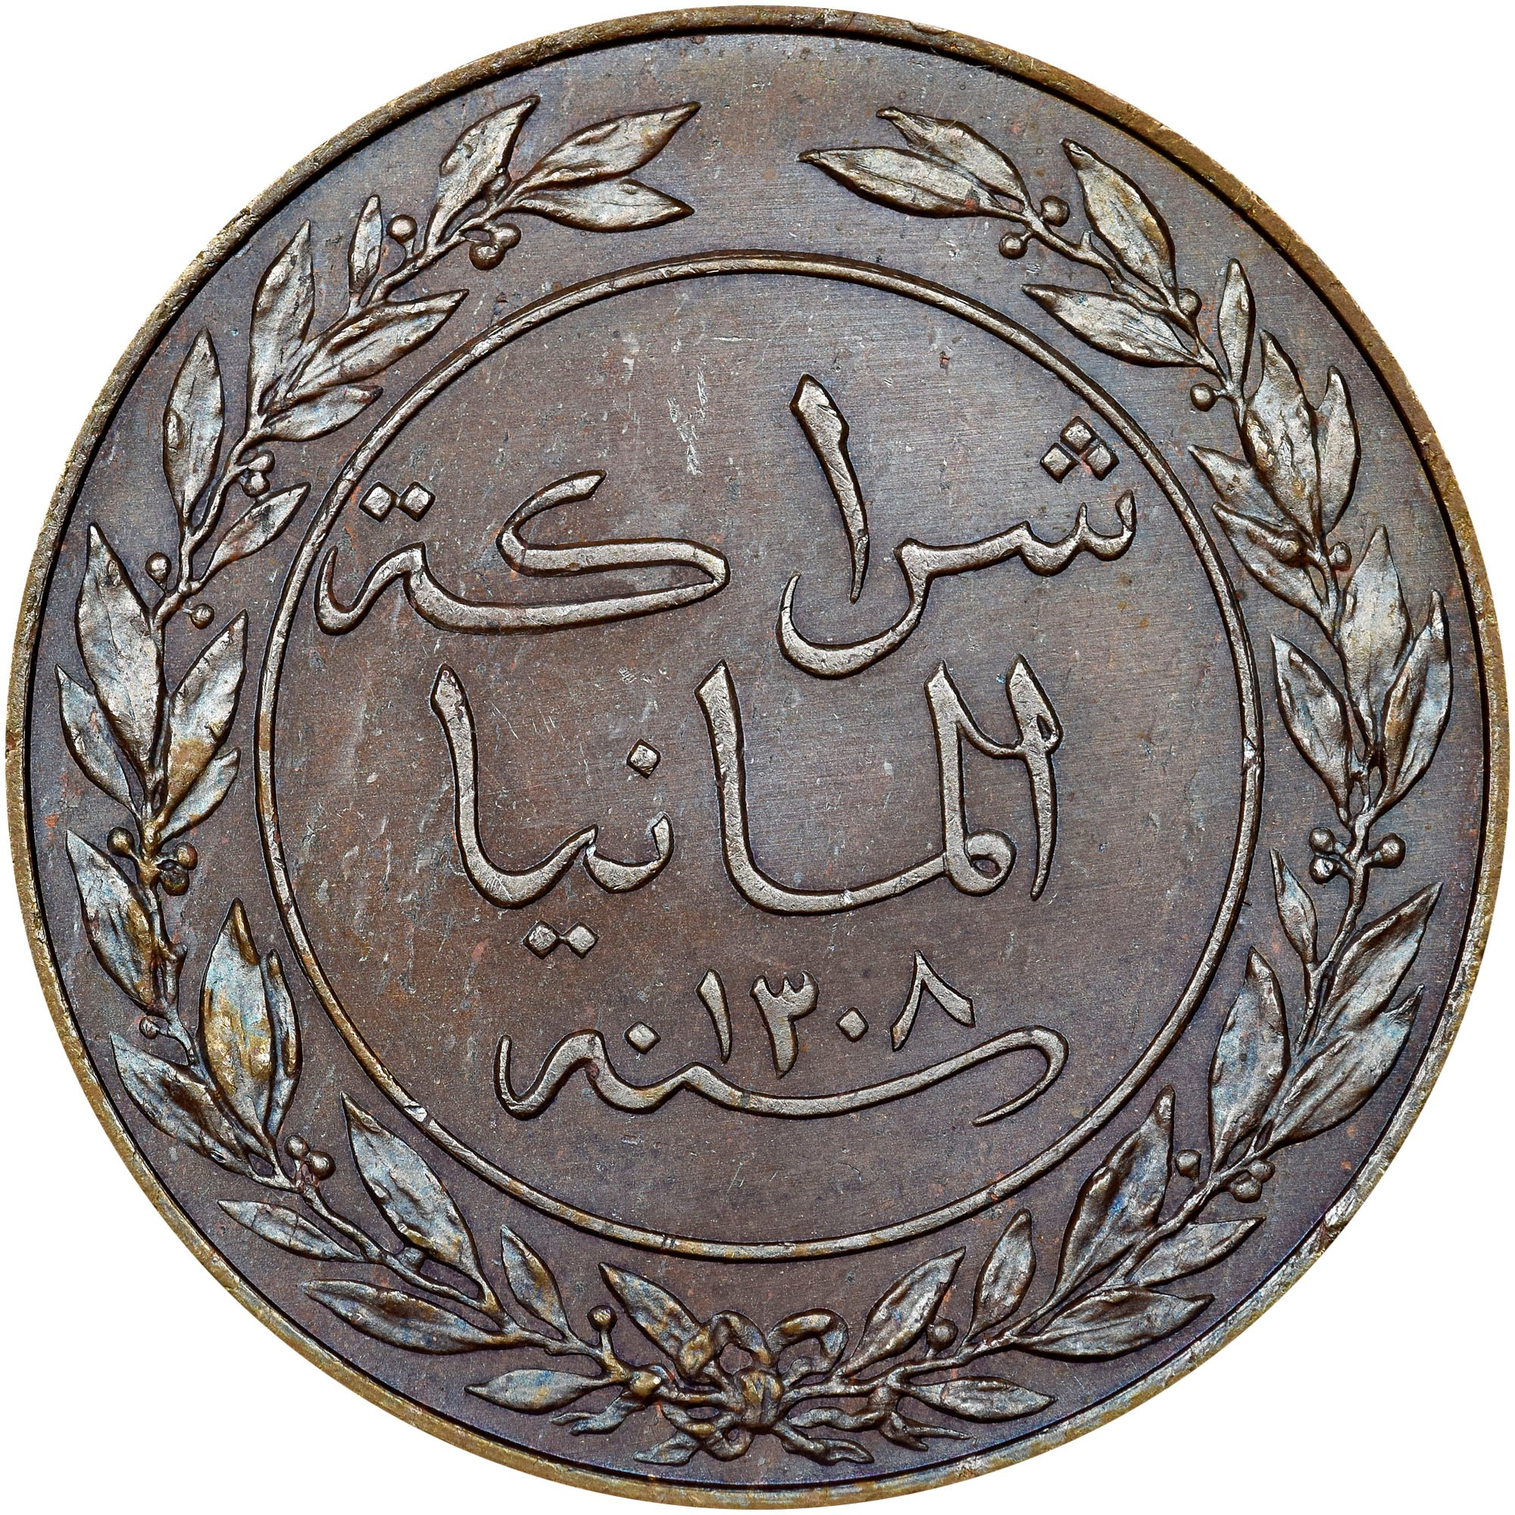
One Pesa
Arabic writing includes date surrounded by a wreath.
The lettering translates to "Germany Partnership” followed by the Anno Hegirae date.
This example reads as ١ one ٣ three ٠ zero ٧ seven or 1307 AH which corresponds to 1890 AD.
64 pesa = 1 rupee

Slide 6
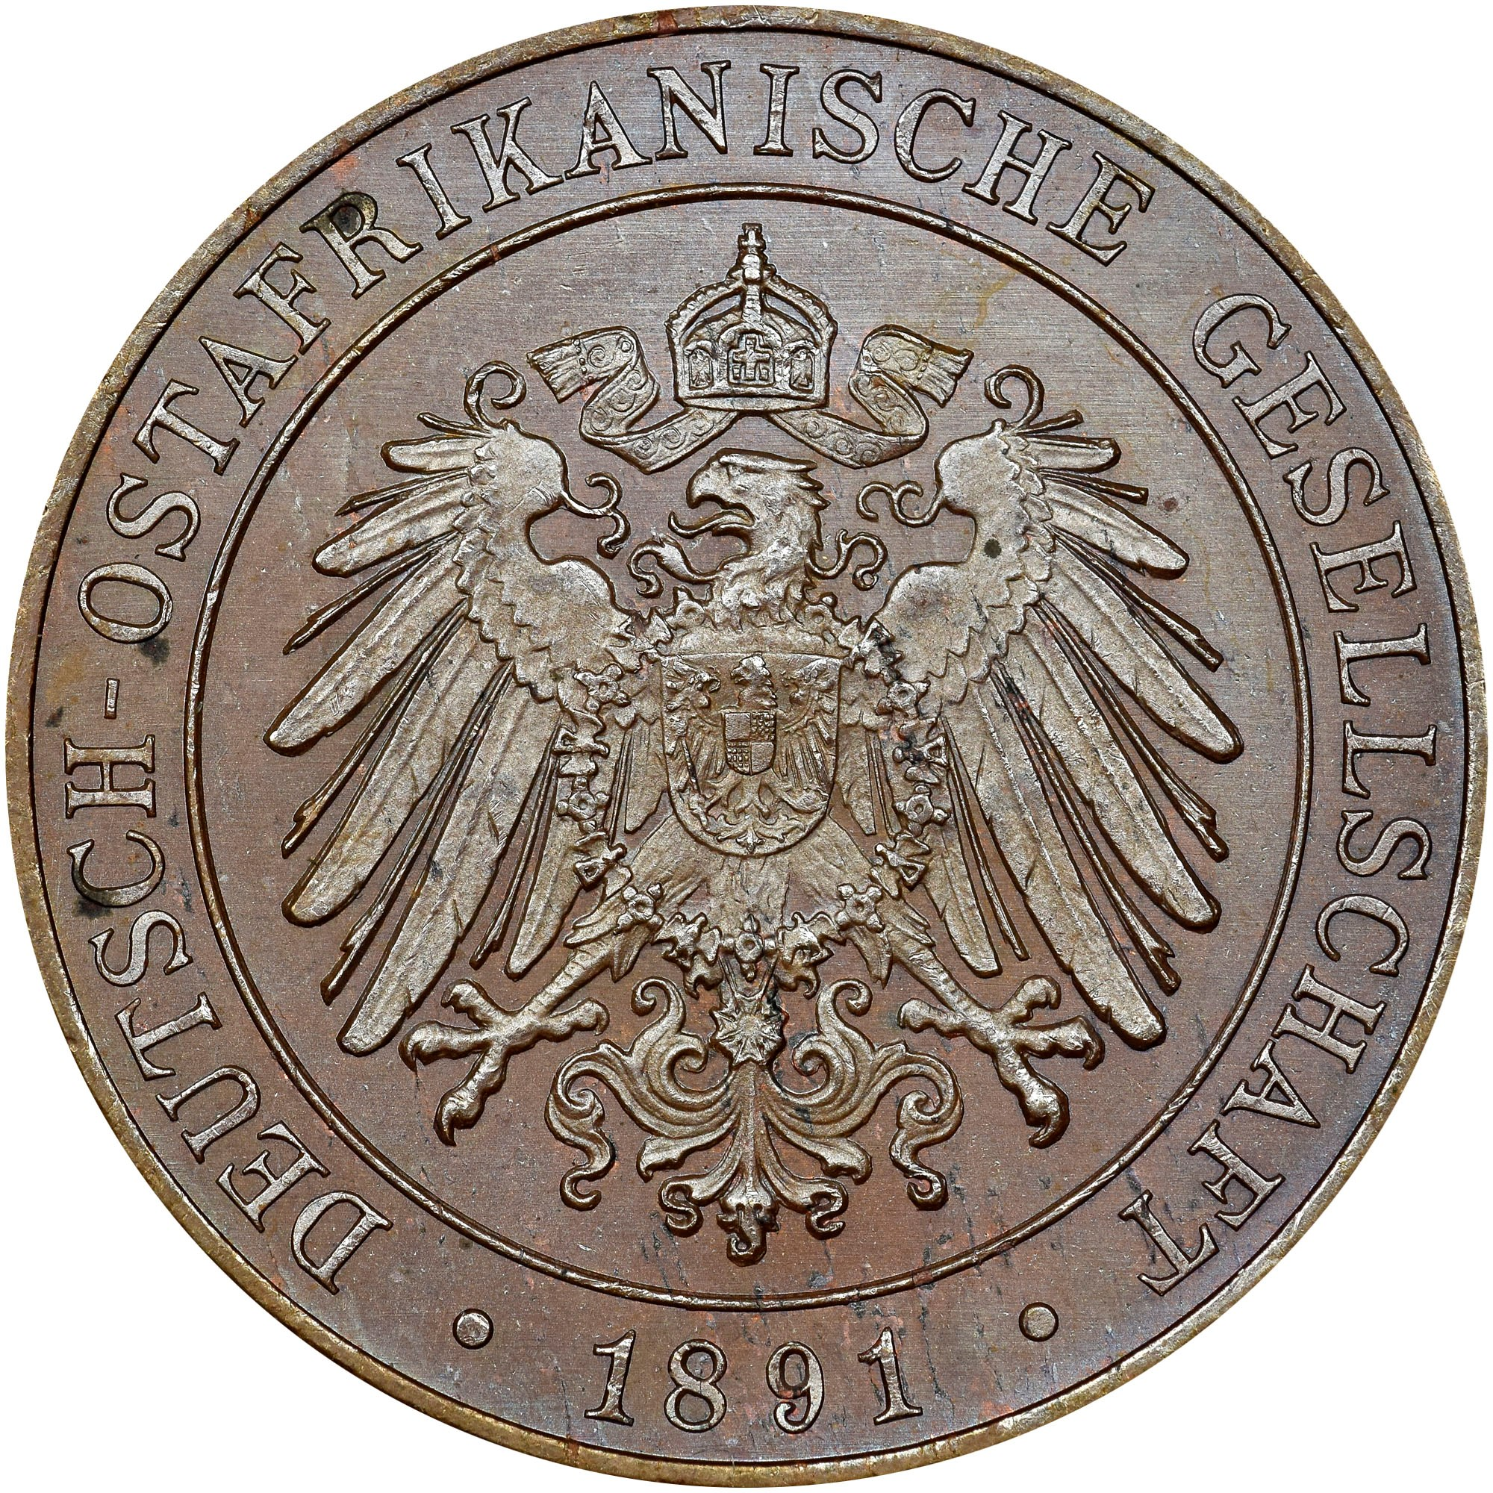
One Pesa
The crowned imperial eagle is on the reverse.

Slide 7
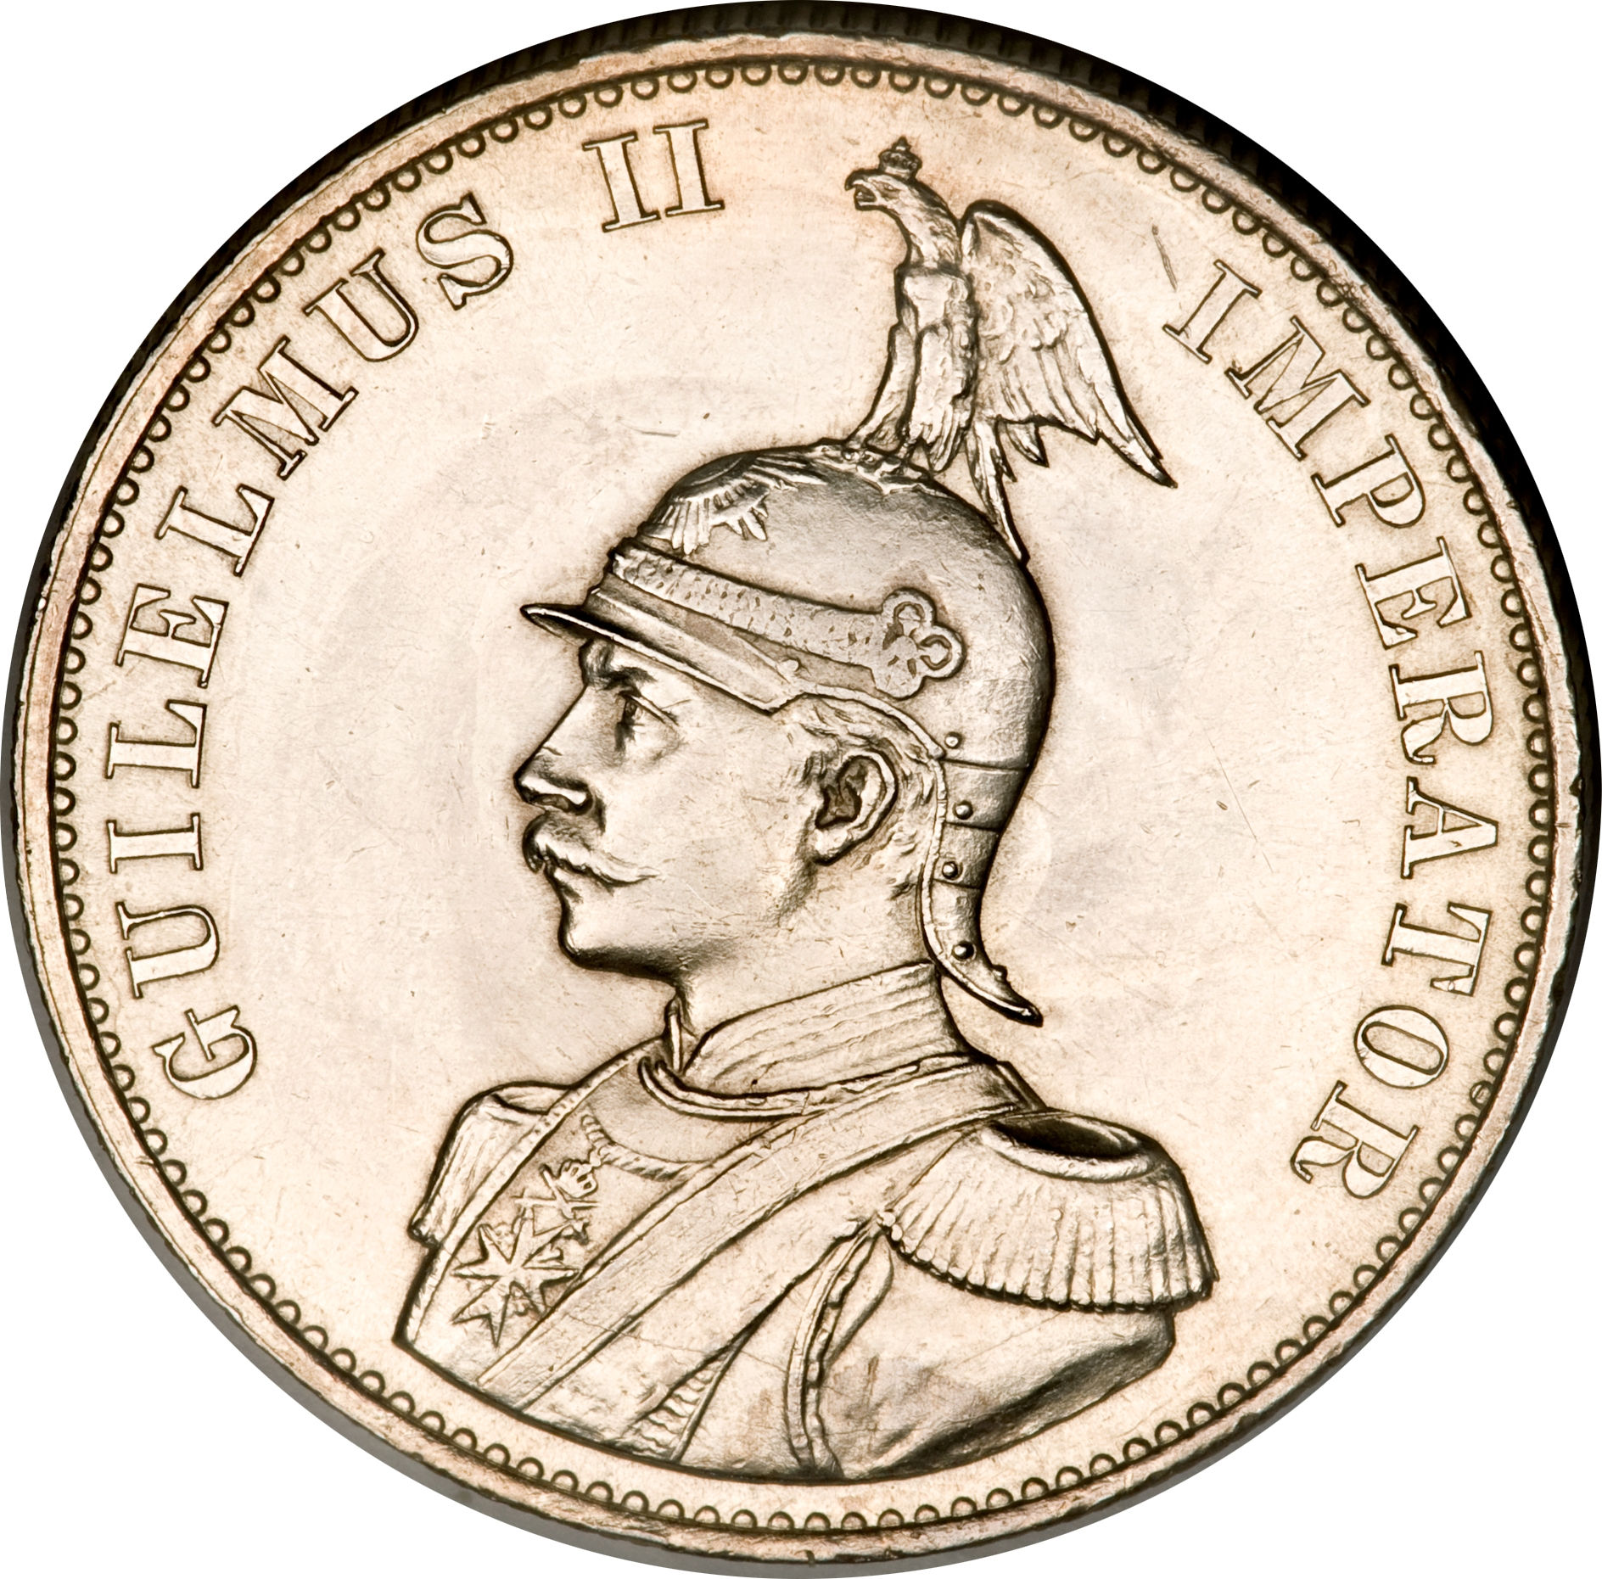
Common Obverse
Silver Coins
¼ Rupee
½ Rupee
Rupee
Two Rupees
In 1891, the relationship between the German East Africa Company rupee and the German mark was fixed at one rupee = 1.33 mark (4 mark = 3 rupees). The name rupie was adopted for colonial use to distinguish the coinage from the Indian and other rupees then in circulation.
The coins’ obverse carried a likeness of Wilhelm II in military dress, wearing a helmet with the Germanic eagle perched on top. The legend surrounding the bust of Wilhelm II reads “Guilelmus II Imperator”.

Slide 8
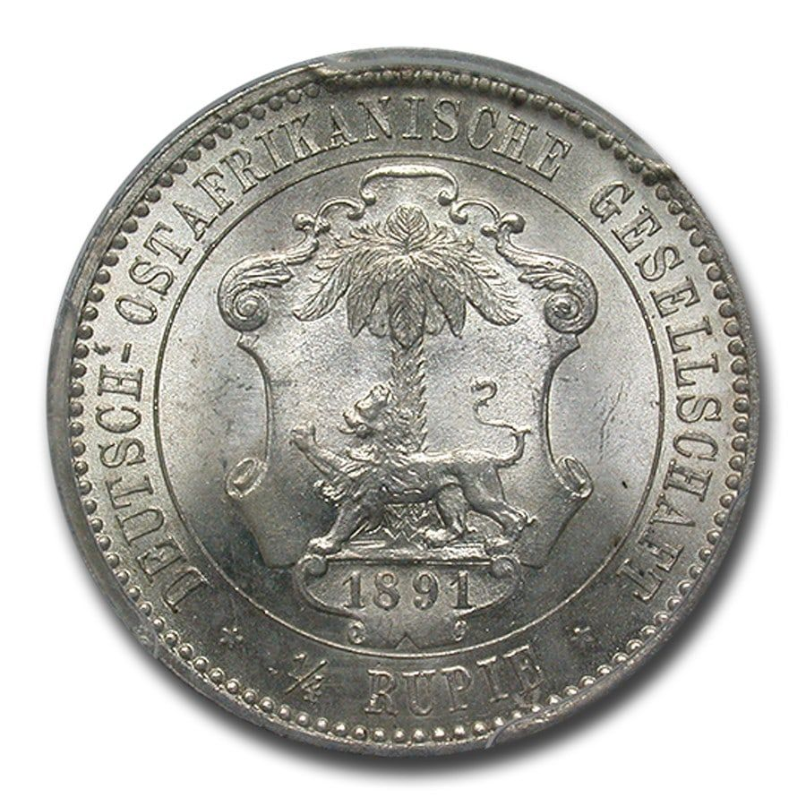
One Fourth Rupee
The ¼ Rupee was minted in 3 years:
  1891
  1898
  1901
The reverse of the rupee coins bears the arms of the German East Africa Company consisting of a lion and palm tree with the date beneath. The inscription surrounding the central shield reads “Deutsche OstAfrikanische Gesellschaft” with value expressed in rupees below.

Slide 9
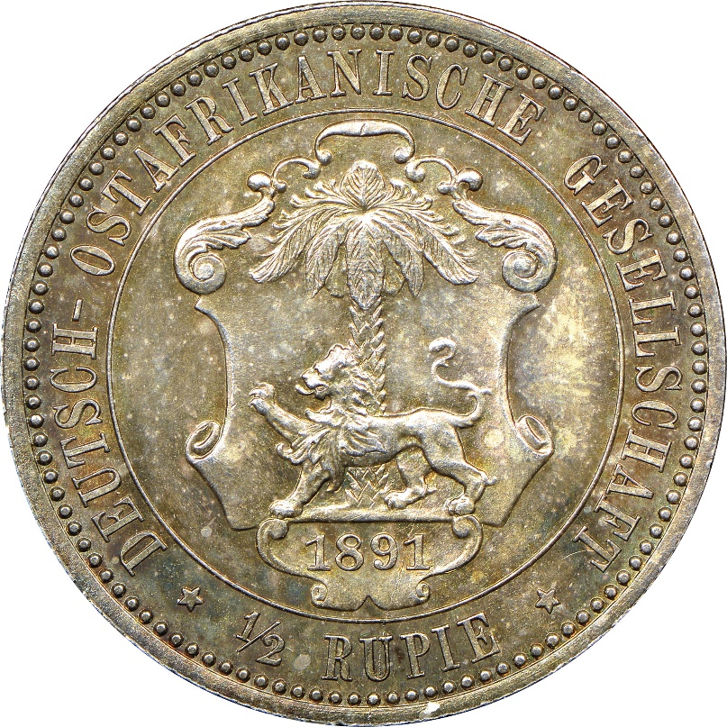
One Half Rupee
The ¼ Rupee was minted in 3 years:
1891
1897
1901
All DOAG coins were minted in Berlin in .917 silver.

Slide 10
One Rupee
The one Rupee was minted each year from 1890 through 1902.

Slide 11
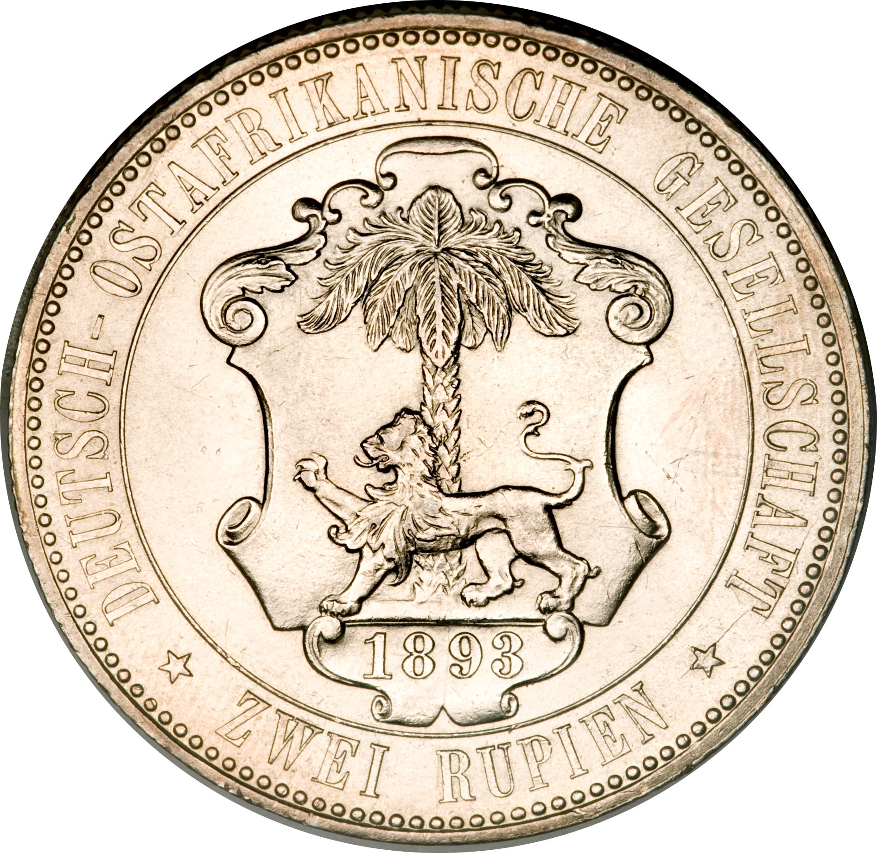
Two Rupees
This coin was minted in 1893 and 1894.
The 1894 coin has a small mintage of 18,000 and is the key coin.

Slide 12
German Imperial Government Issues
It wasn’t long before Germany realized that the East Africa Company lacked the administrative ability to properly manage the colony.
In 1897 the imperial government proclaimed the area the colony of German East Africa (Deutsche Ostafrika) which is referred to as “D.O.A”. Shortly after, a separate Colonial Department was set up in Berlin to assist in development.
Coin production of the German East Africa Company ceased in 1904. From 1904 onwards, the coinage was taken over by the imperial German government.

Slide 13
DOA
In total, DOA coins consisted of twelve types.
All pre-World War I coins were minted at the Berlin (the “A” mintmark ) and Hamburg (the mintmark “J”).
The first of the new DOA coins were minted in 1904 in the following denominations:
½, 1 heller with 100 heller = 1 rupee
¼, ½ and 1 rupee.
The obverse of the silver rupee coins was unchanged from the German East Africa Company issue. New dies were cut for the reverses consisting of the value (i.e., “1 rupee”) in the center surrounded by crossed palm fronds with “Deutsche Ostafrika” above, and date with mintmark below.

Slide 14
DOA
The bronze heller denominations depicted the imperial crown at the center with “Deutsche Ostafrika” above and date below on the obverse and value surrounded by crossed laurel branches on the reverse.
New 5 heller bronze and 10 heller copper nickel coins were added in 1908.
In 1913 the bronze 5 heller was replaced by a much smaller copper nickel type with a center hole.
A similar 10 heller copper nickel piece was struck from 1909 to 1914.

Slide 15
Common Obverse
Copper Coins
½ Heller
Heller
Five Heller

Slide 16
½ Heller
Minted in 1904 - 1906

Slide 17
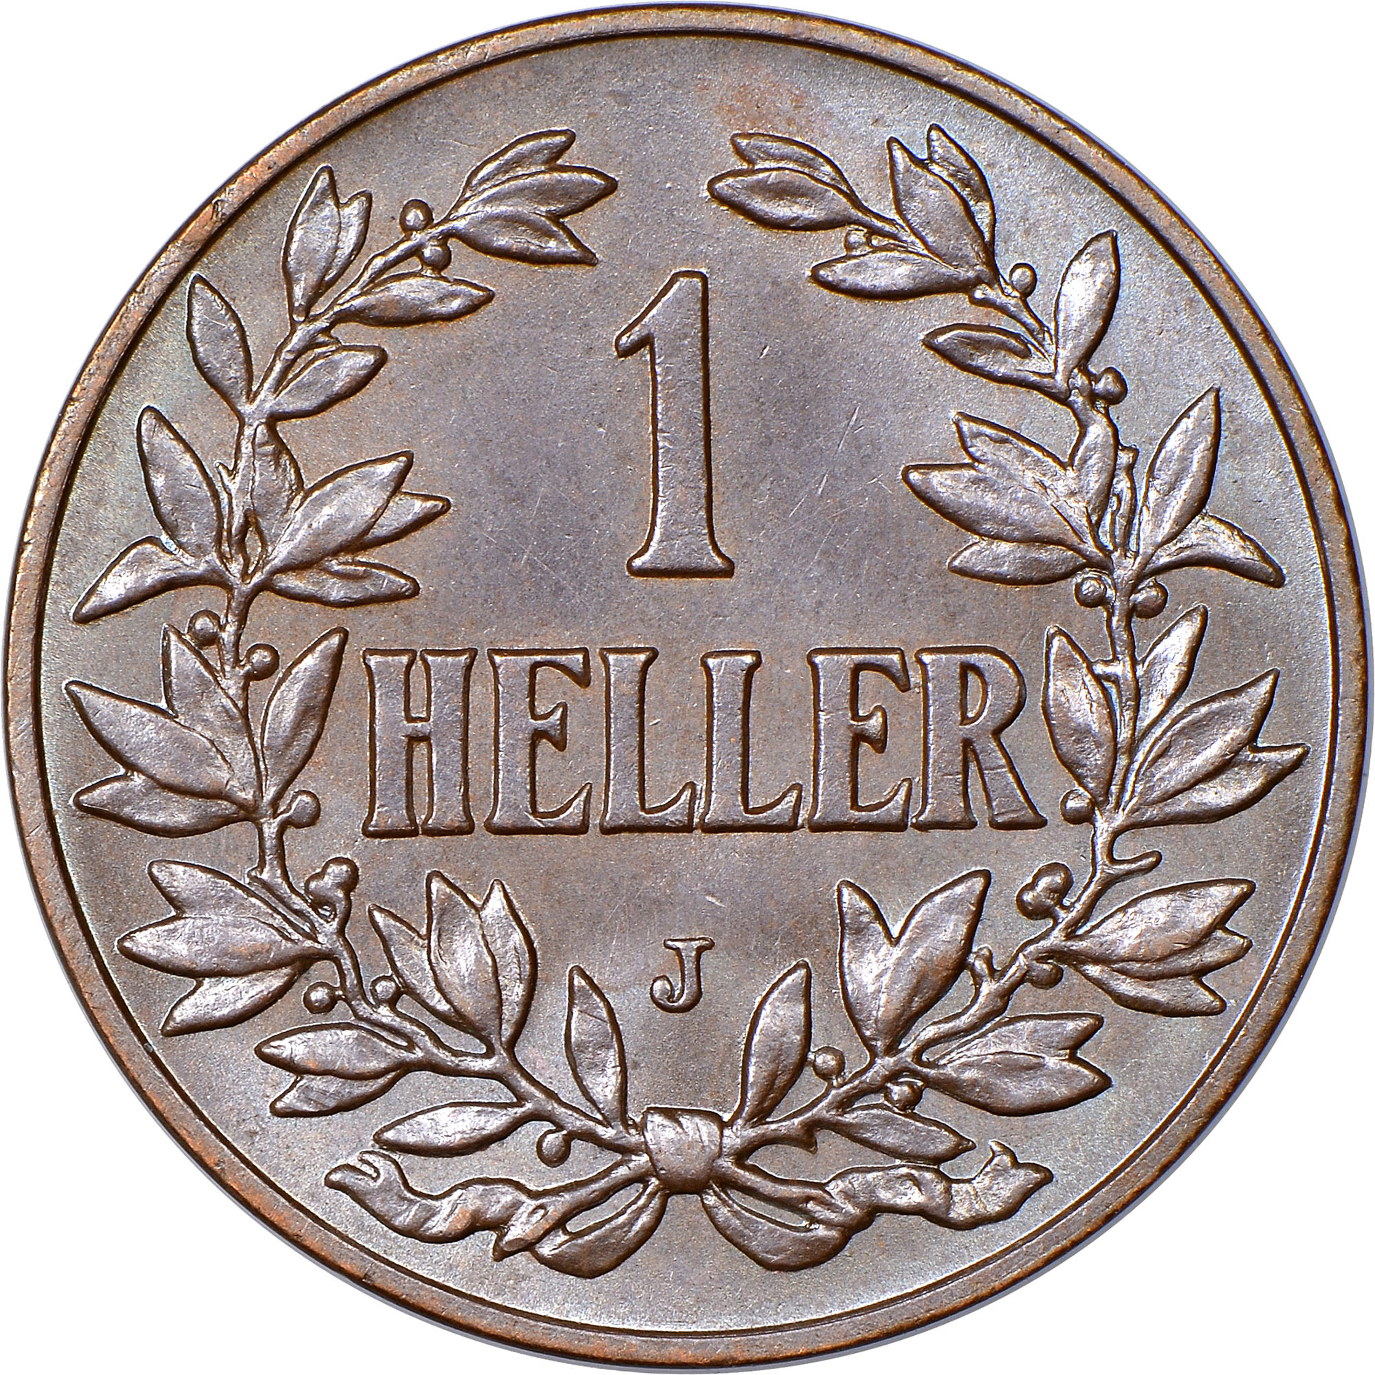
Heller
Minted in 1904 - 1913

Slide 18
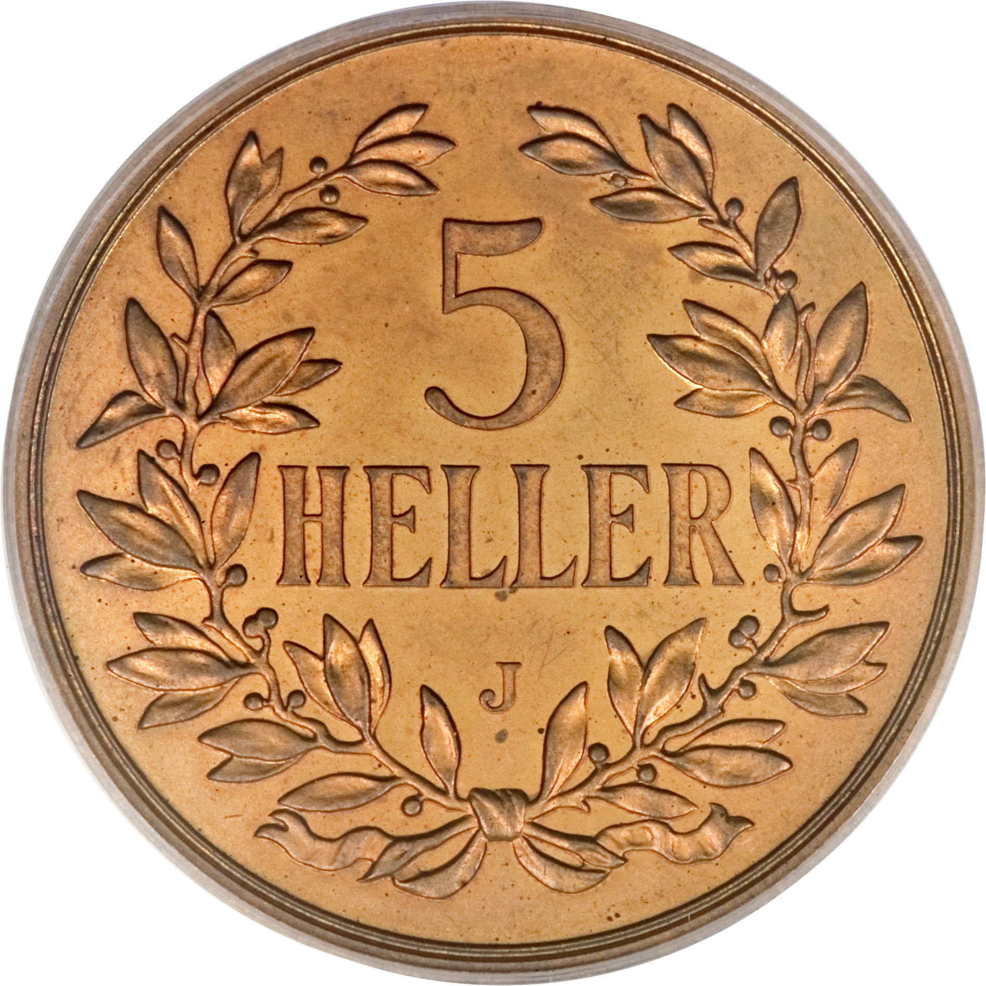
Five Heller
Minted in 1908-09

Slide 19
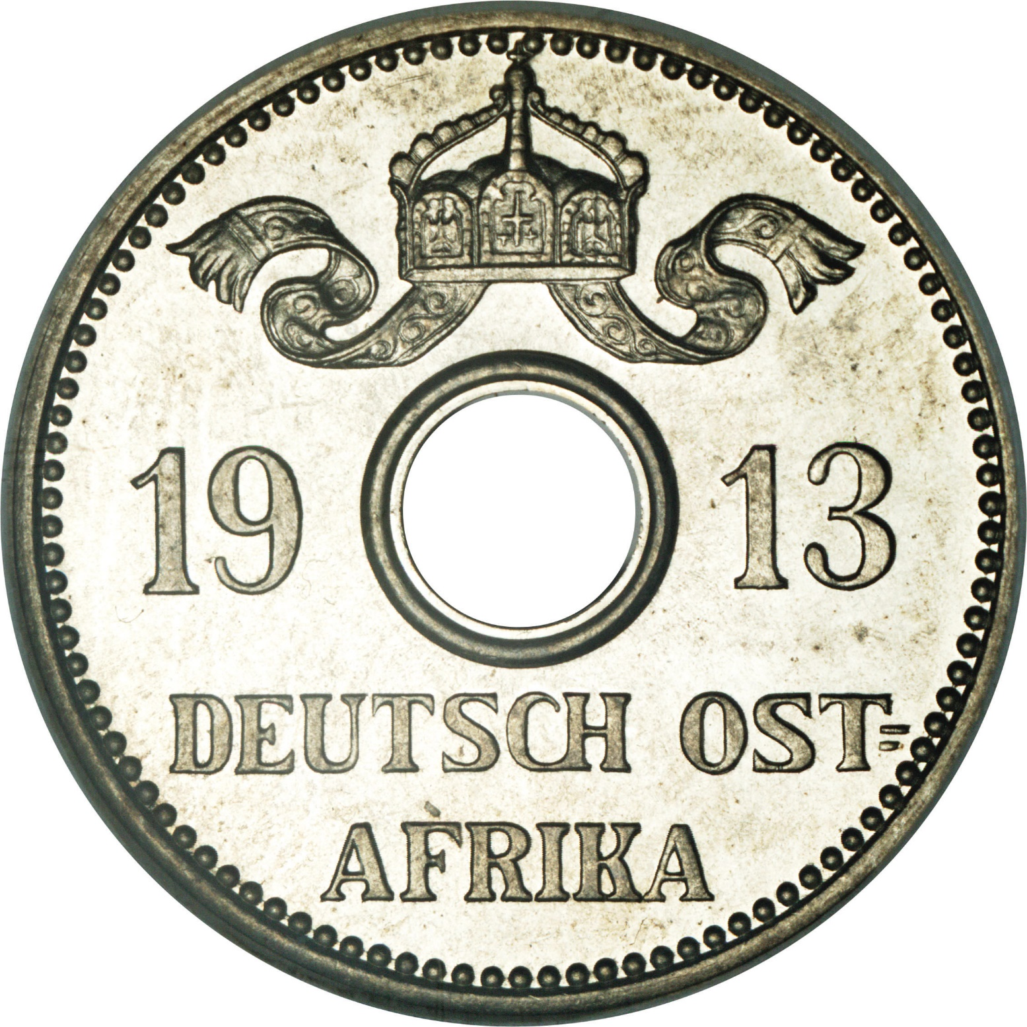
Common Obverse
Copper Nickel Coins
5 Heller
10 Heller

Slide 20
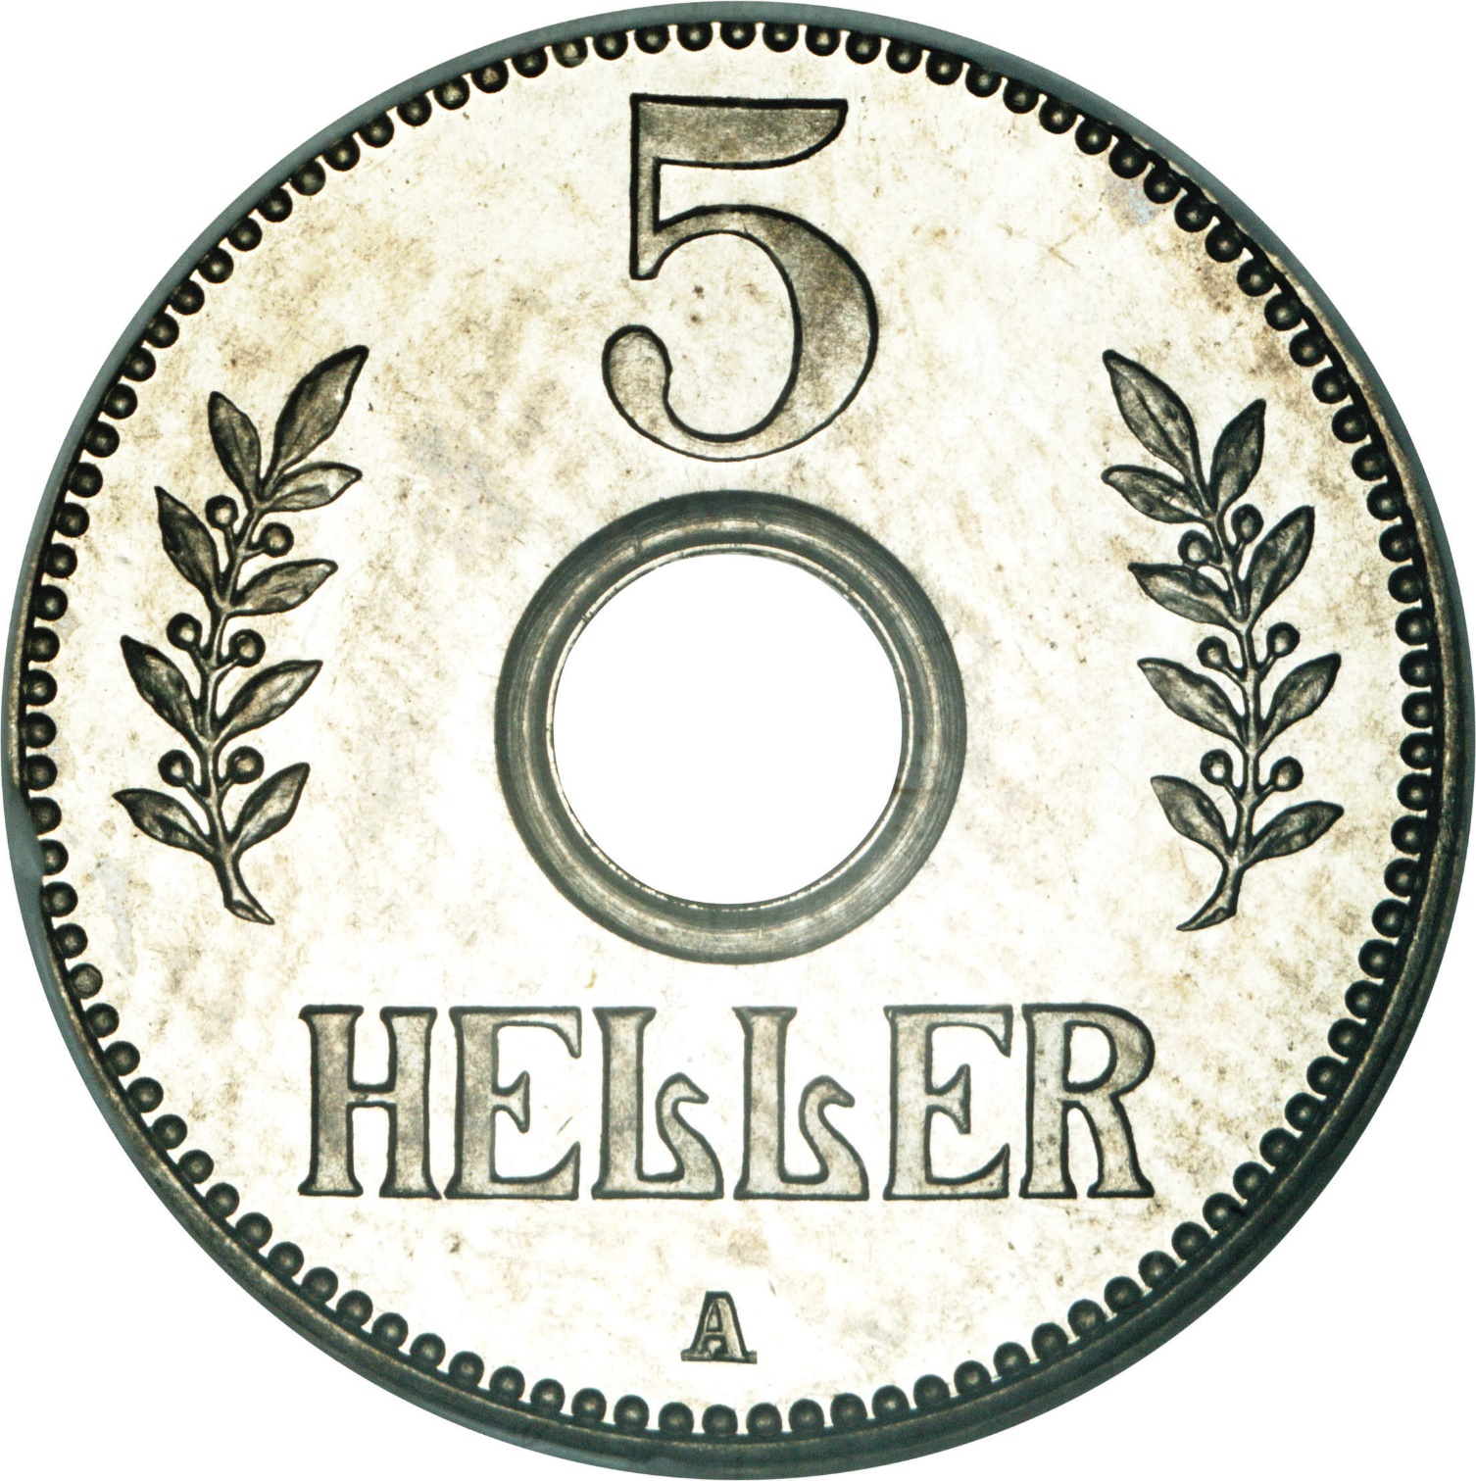
Five Heller
Minted in 1913-1914

Slide 21
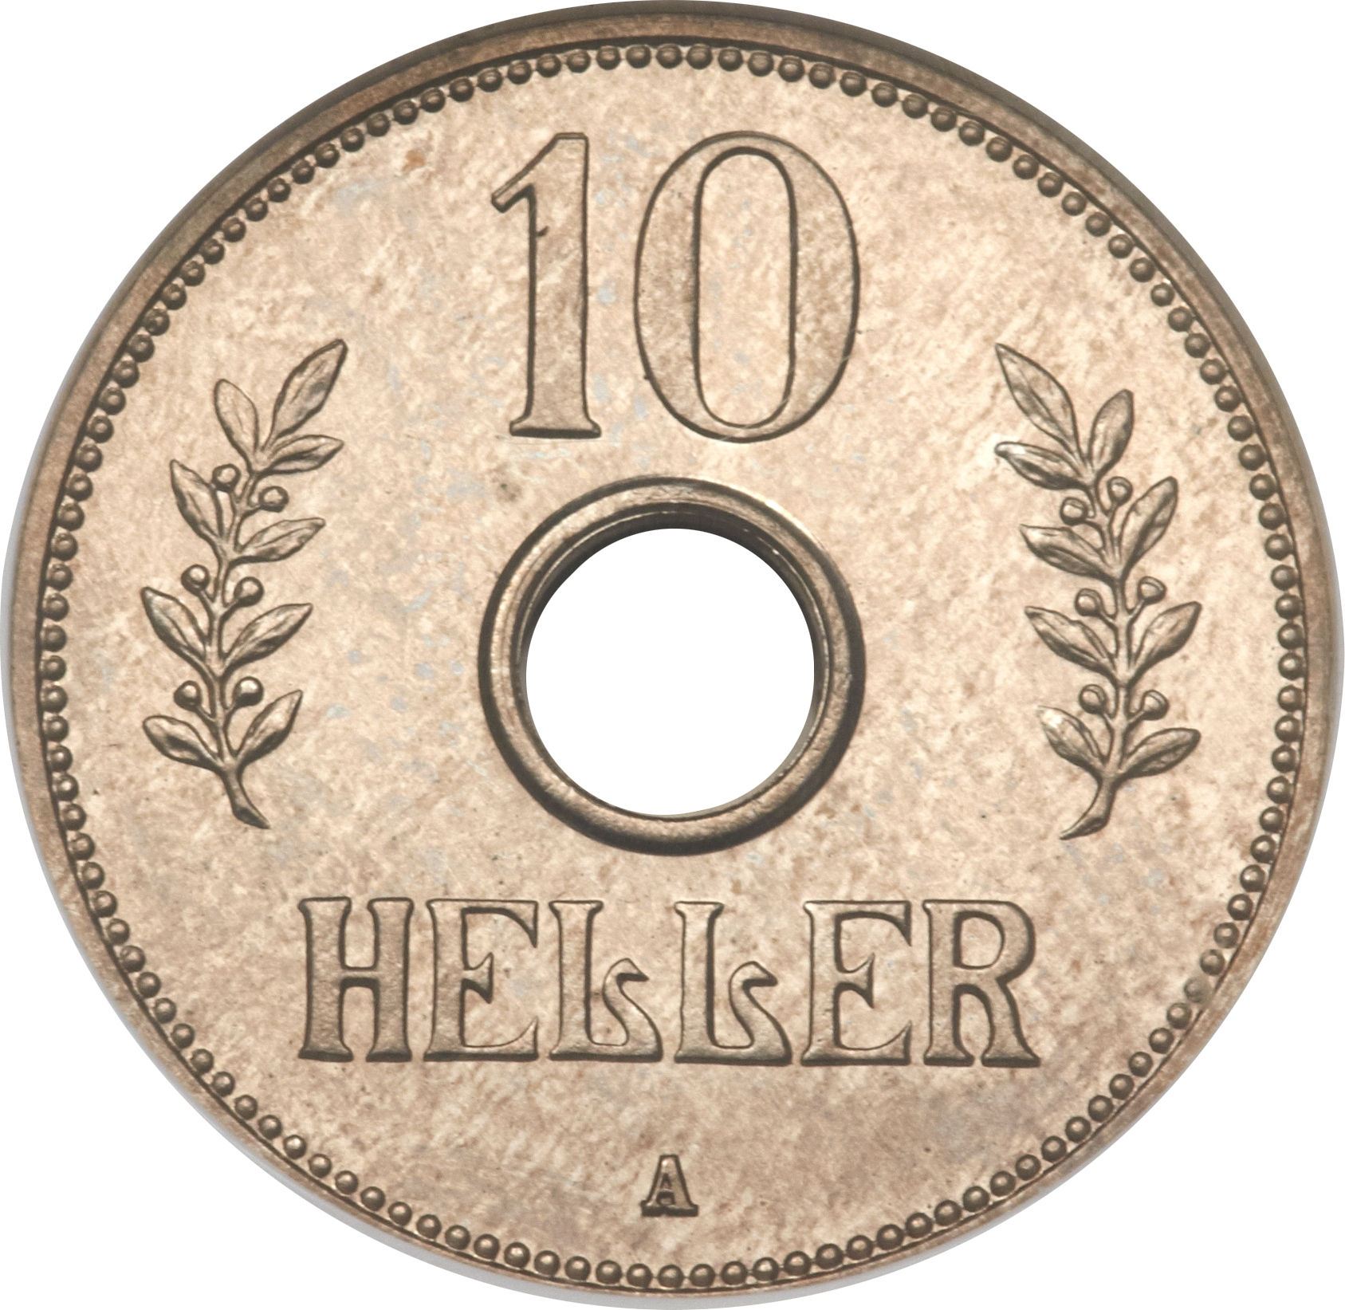
Ten Heller
Minted in 1909-1911 and 1914

Slide 22
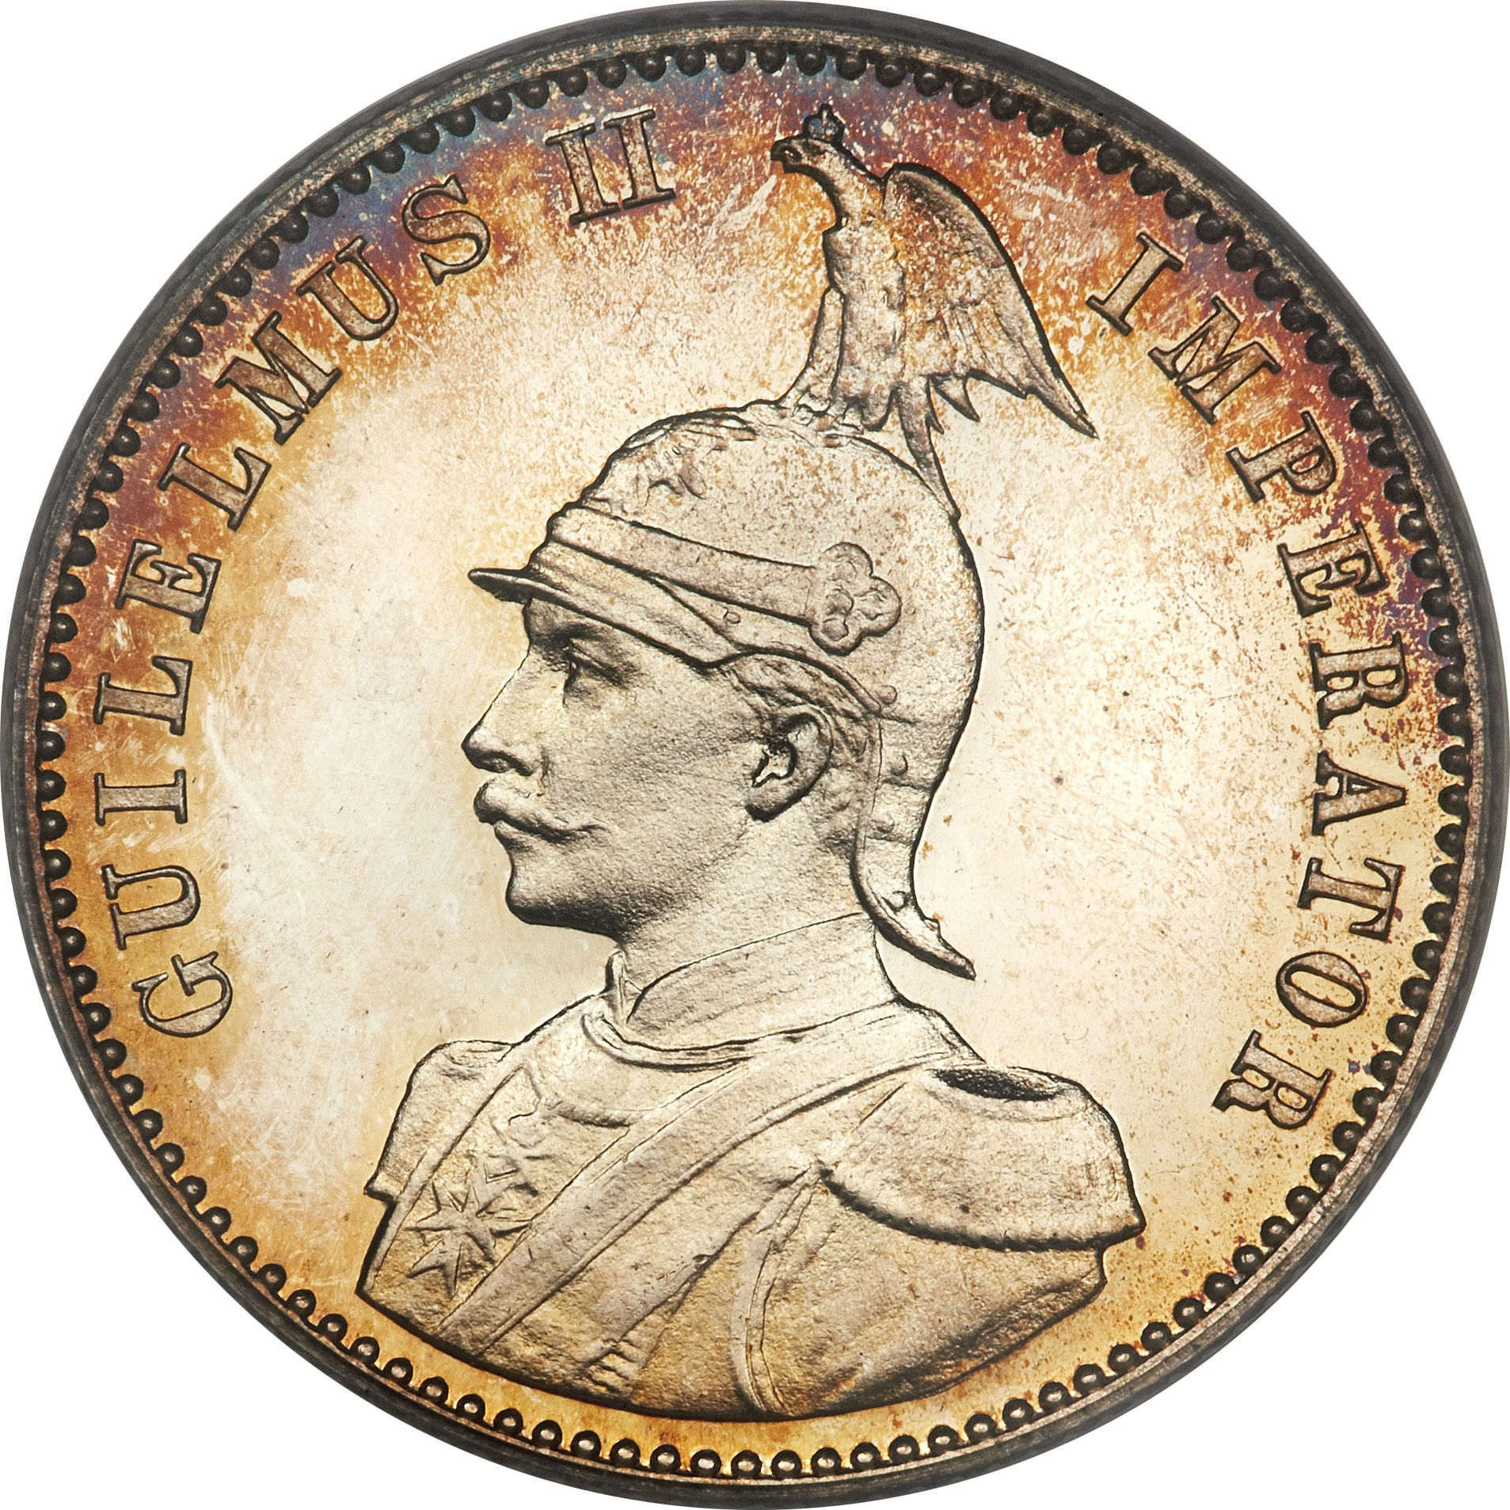
Common Obverse
Silver Coins
¼ Rupee
½ Rupee
One Rupee

Slide 23
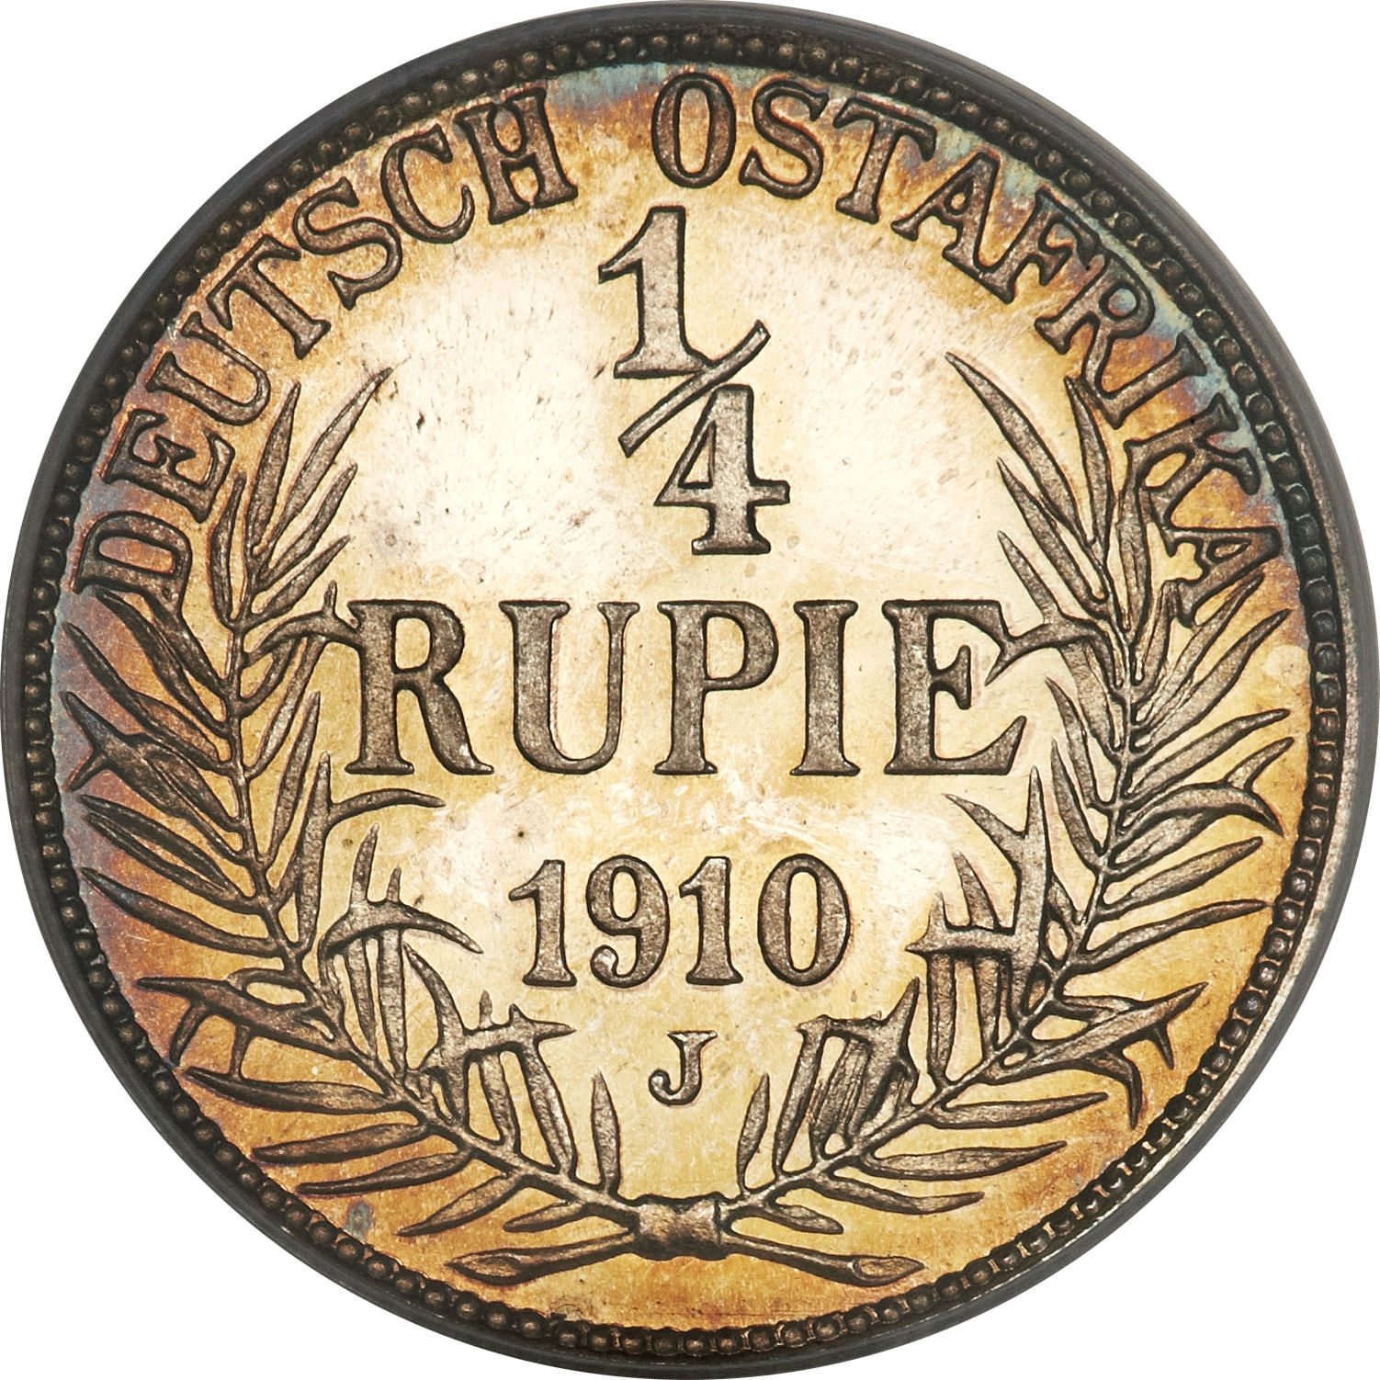
¼ Rupee
Minted in 1904, 1906, 1907, 1909, 1910, 1912-1914

Slide 24
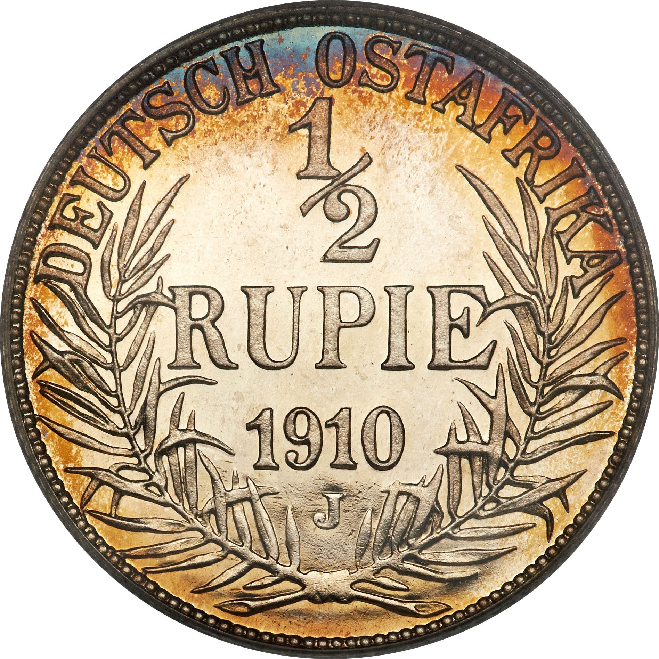
½ Rupee
Minted in 1904, 1906, 1907, 1909, 1910, 1912-1914

Slide 25
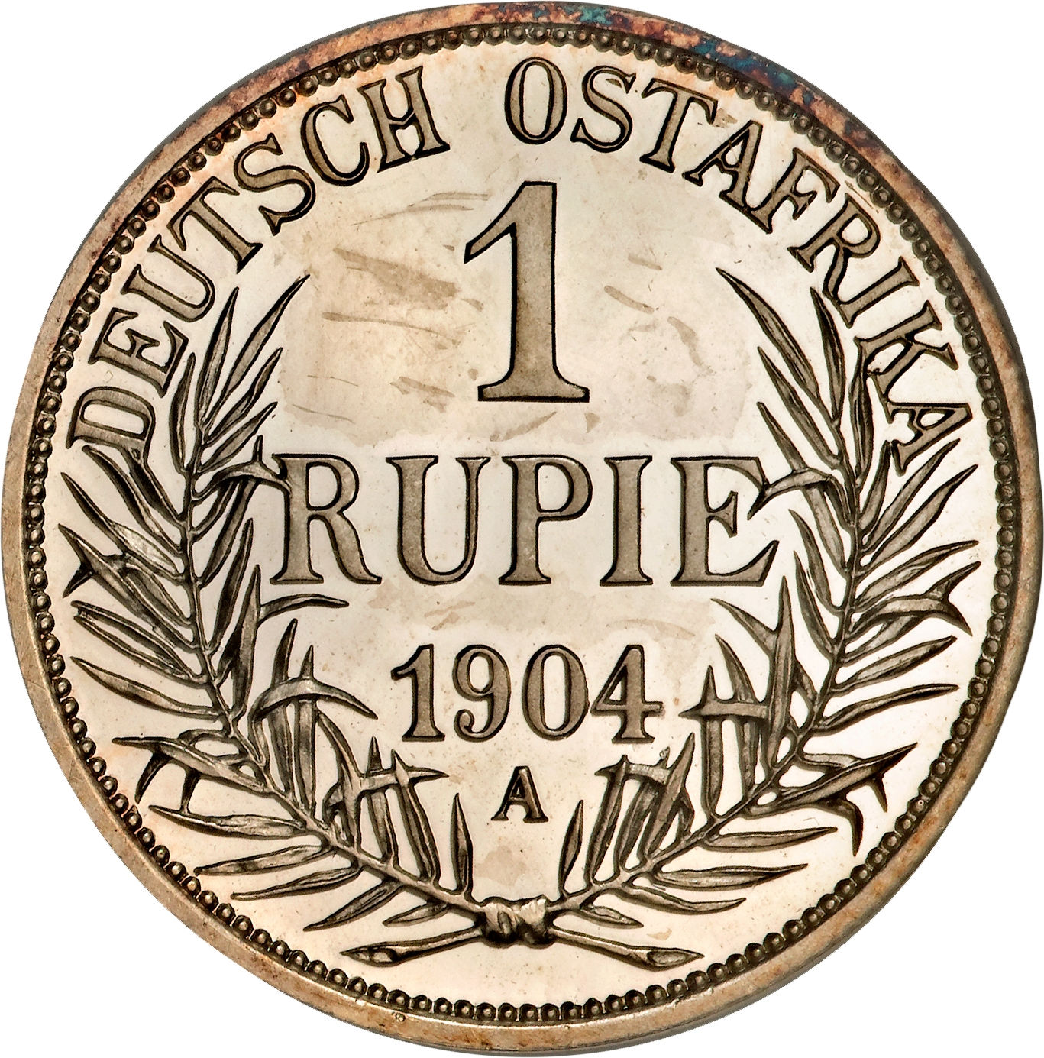
1 Rupee
Minted in 1904 - 1914

Slide 26
Provisional World War I Issues
German East Africa cut off from the Fatherland by the British navy.
German Colonel von Lettow-Vorbeck found himself stuck with just a few hundred German officers and a few thousand (very well-disciplined) native troops.
Coins were hoarded.
One of the last ships to arrive in GEA before the British blockade went up had been carrying a big shipment of paper, so printing emergency banknotes was no problem.

Slide 27
Provisional World War I Issues
The railroad that the Germans built stretched from Dar es Salaam to Tabora, deep inland.
The Colonel set up shop in Tabora after Dar es Salaam was overrun and managed to set up a mint in a train car using equipment salvaged from a sunken German warship, Konigsberg.
The dies that he used were engraved anew every time, rather than being copied from one set of master matrices, so there are a lot of varieties in this series.
He also saw the need to transform a pile of gold bullion into actual coins in order to pay off his soldiers and facilitate local commerce. The British sovereign was very popular in the area, so the Colonel set to work creating gold coins with a value of 15 rupien, roughly equal to one sovereign. One coin was given to every soldier in his irregular army, with the rest being used in local trade.

Slide 29
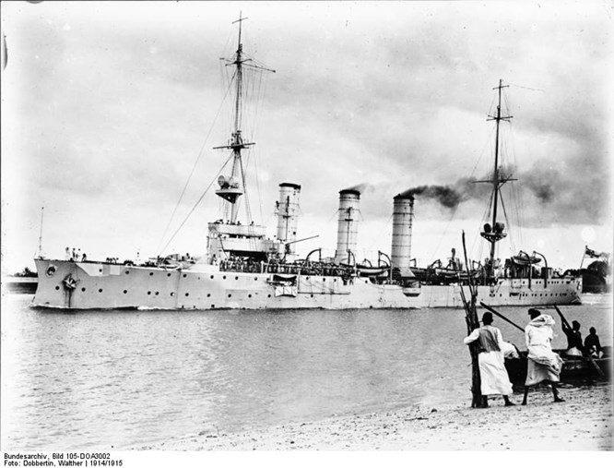

Slide 30
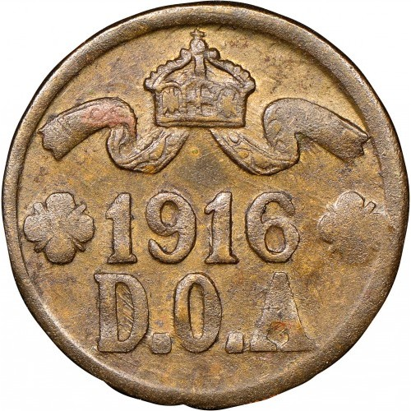
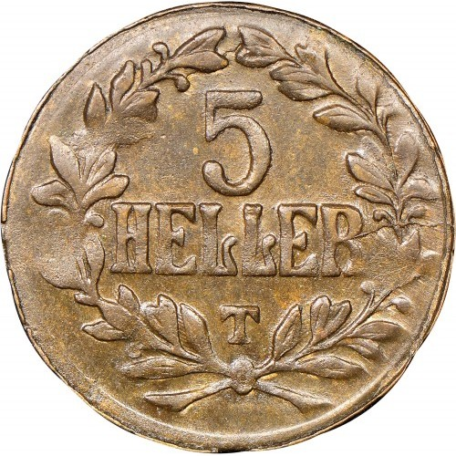
Two types of the brass provisional 5 heller coins exist, with 30,000 being struck.

Slide 31
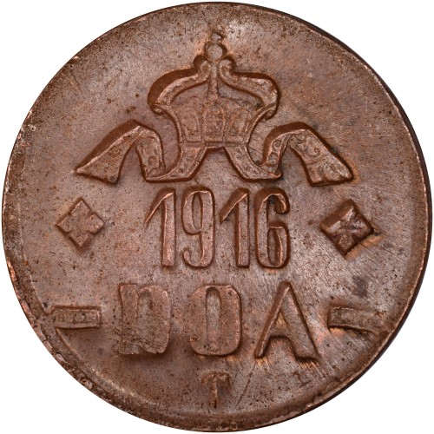
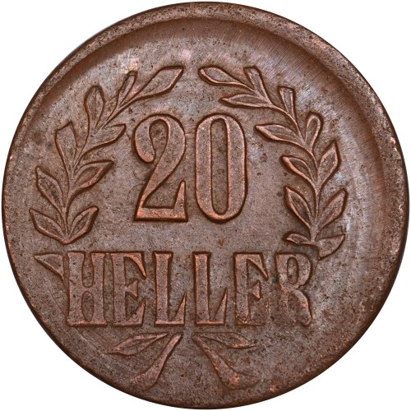
Striking 20 heller coins made of copper and brass from used shell casings, includes a total of twelve varieties, six of brass and six of bronze.
A total of 300,000 brass and 1,600,000 provisional 20 heller coins were produced before the Tabora mint fell to the invading Belgian army.

Slide 32
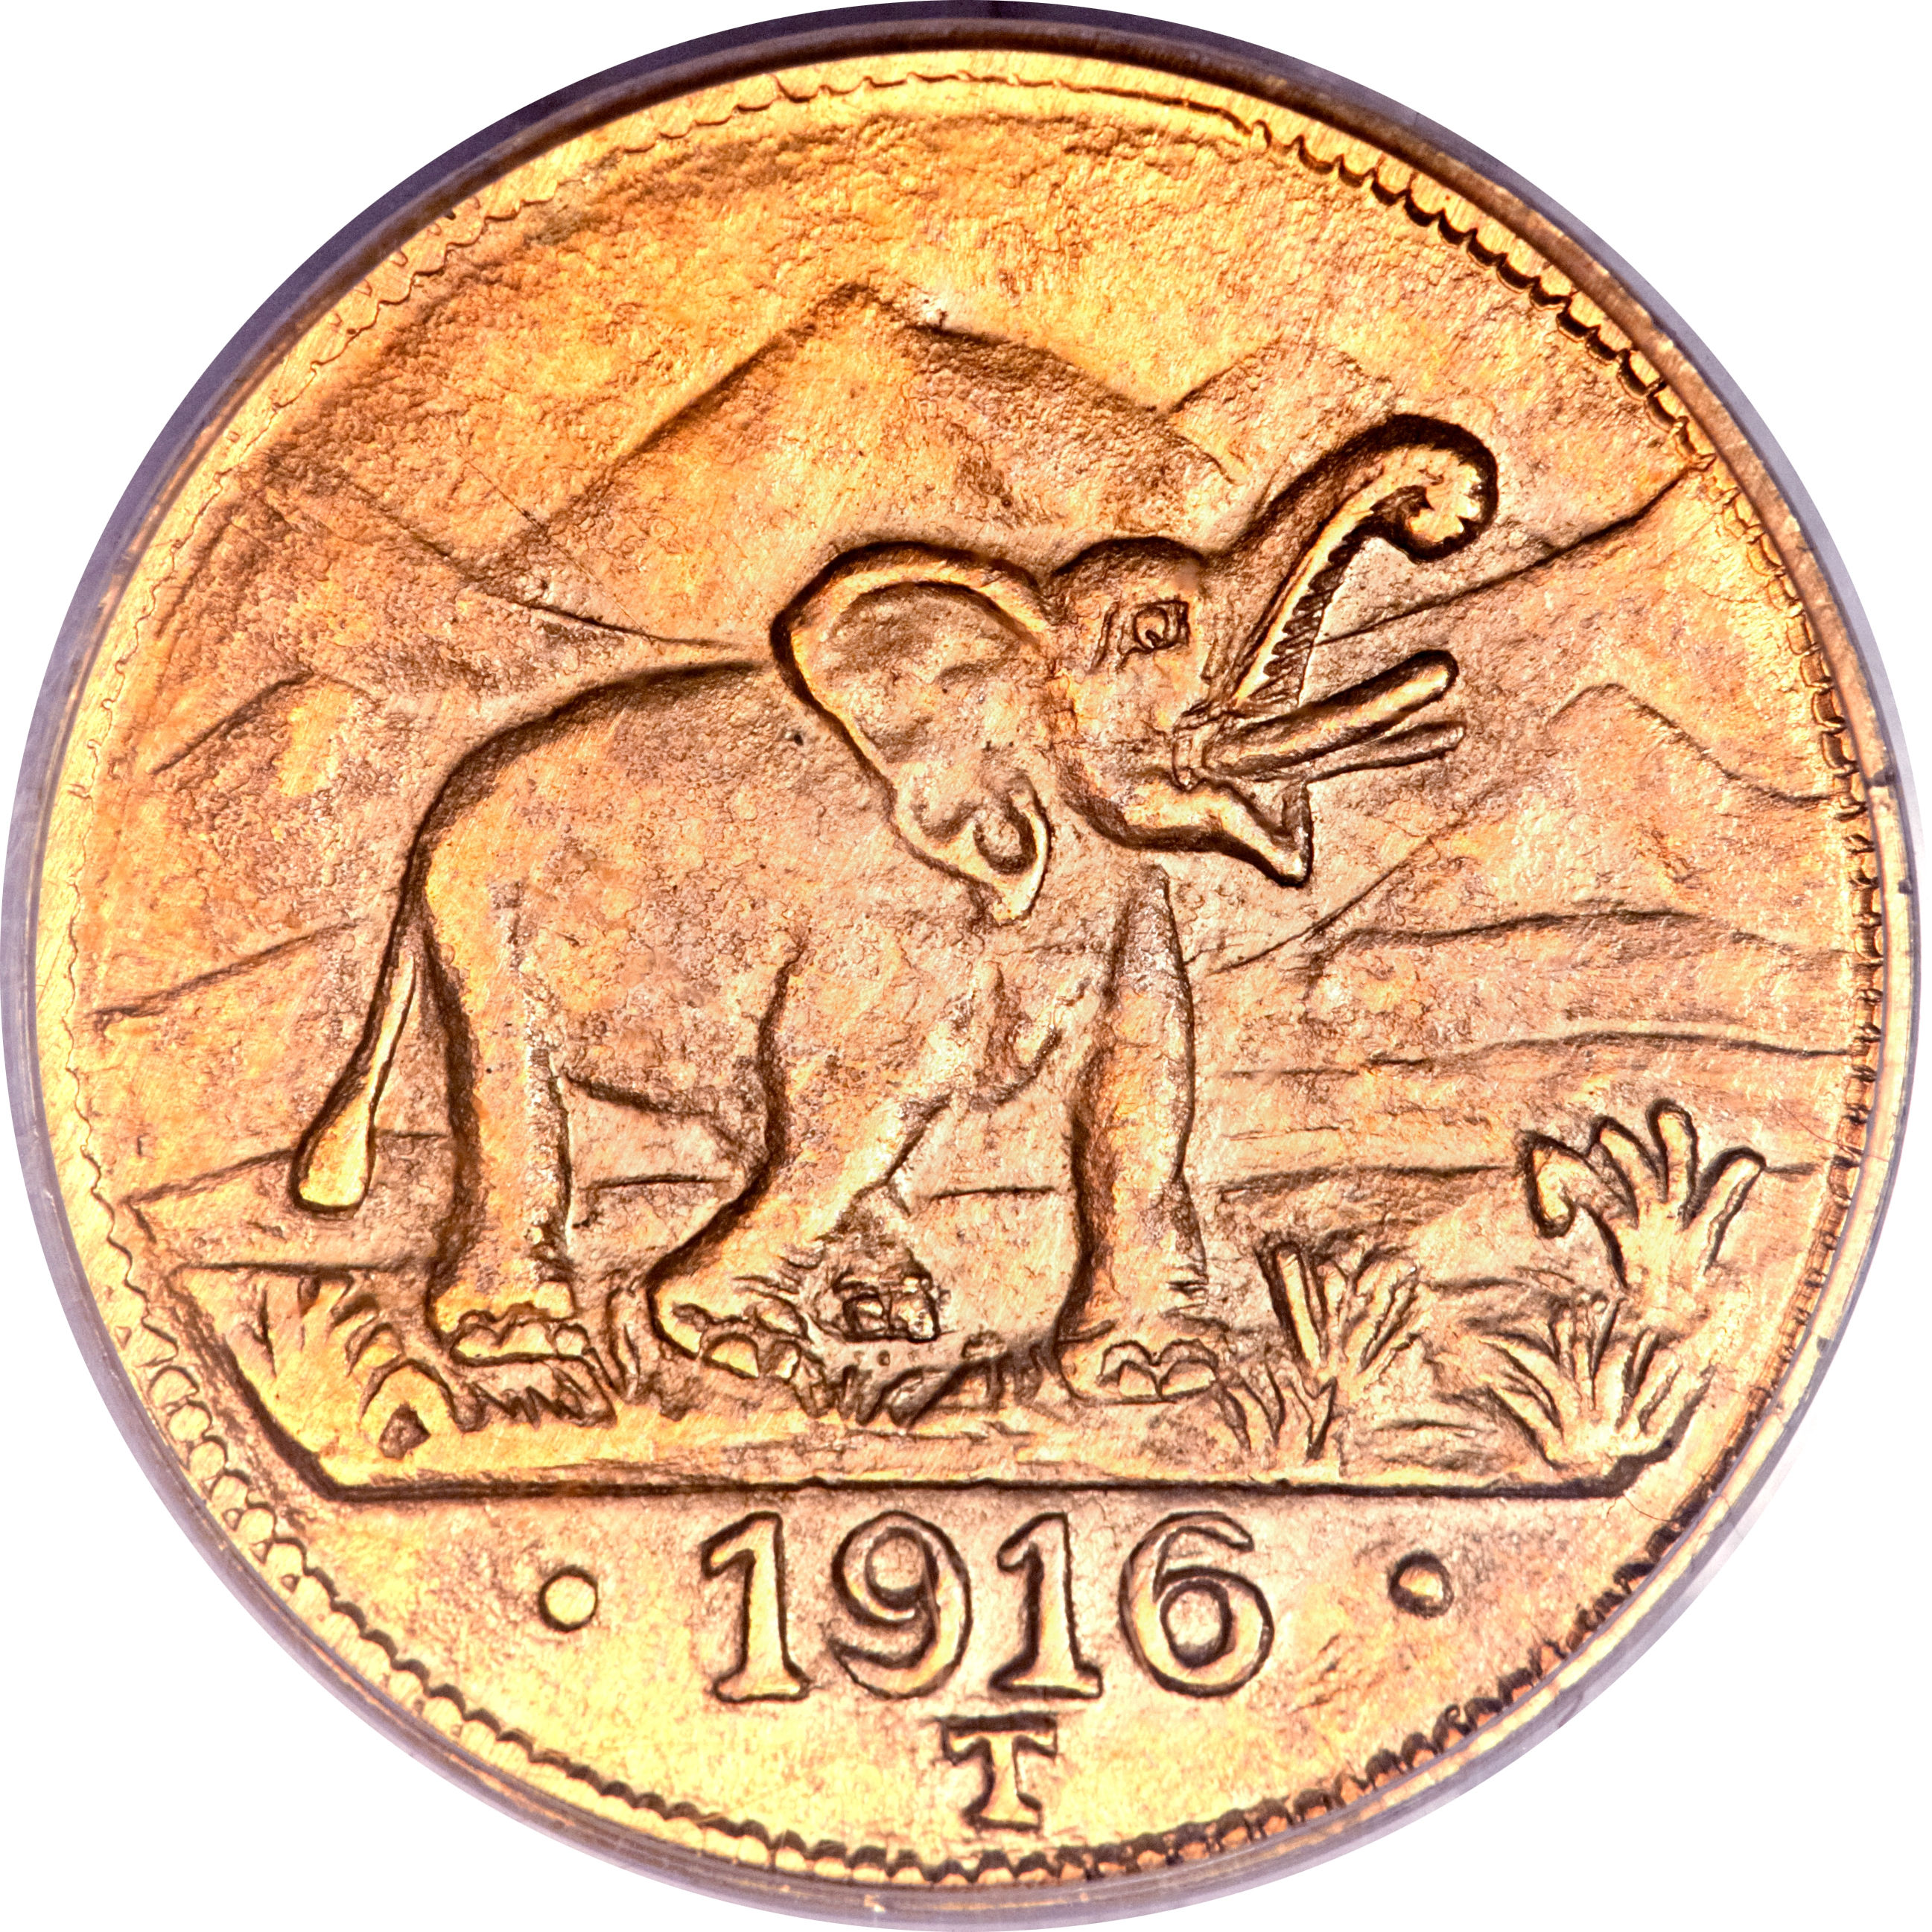
The Tabora Pound
The "Tabora Pound", a gold coin valued
at 15 Rupees
The gold coins were needed
to pay the native troops.
The minting was possible because
of a small gold mine in operation not
very far away from Tabora from which
the gold used in the coins was mined.
It was minted by a bank in a temporary
mint in an adapted train car.
The steam from the train to which the
"mint car" was attached drove
a palm oil press.
Mintage: 16,198

Slide 33
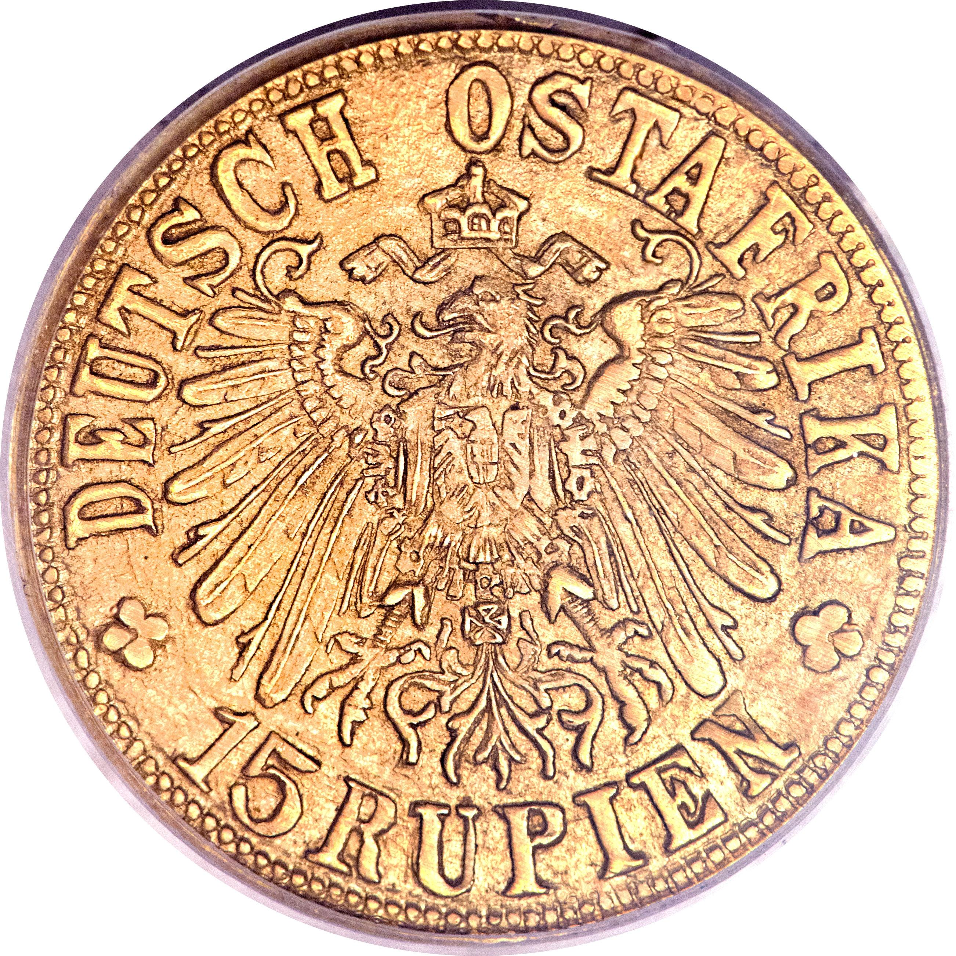

Slide 34
The German colonial administration could call on a military Schutztruppe ("Protection force") of 260 Europeans and 2,470 Africans, in addition to 2,700 white settlers who were part of the reserve.
Nearly 400,000 Allied soldiers, sailors, merchant marine crews, builders, bureaucrats and support personnel participated in the East Africa campaign.

Slide 35
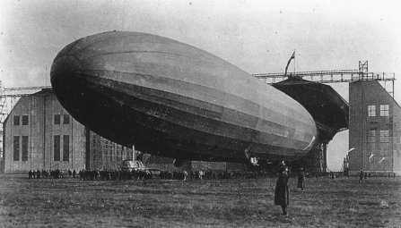
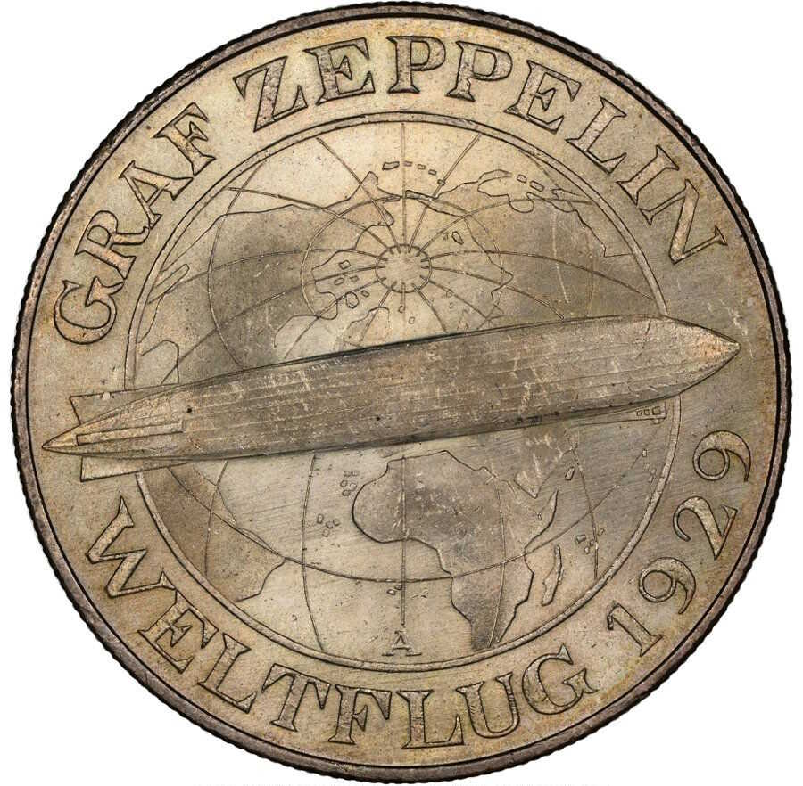
In September 1917, after several trial runs, a zeppelin was flown to Bulgaria. From there it flew across Turkey, crossed the Mediterranean, down the length of British controlled Egypt and into the Sudan.
In Khartoum, turned back.
The L-59 had been airborne for ninety-five hours and had traveled nonstop for 4,220 miles.

